Slide 1

Next Generation Teaching and Learning
Charles Severance
Sakai PMC Chair
LongSight, Inc.
University of Michigan
Apereo South Africa Conference
10-March 2016

Slide 2
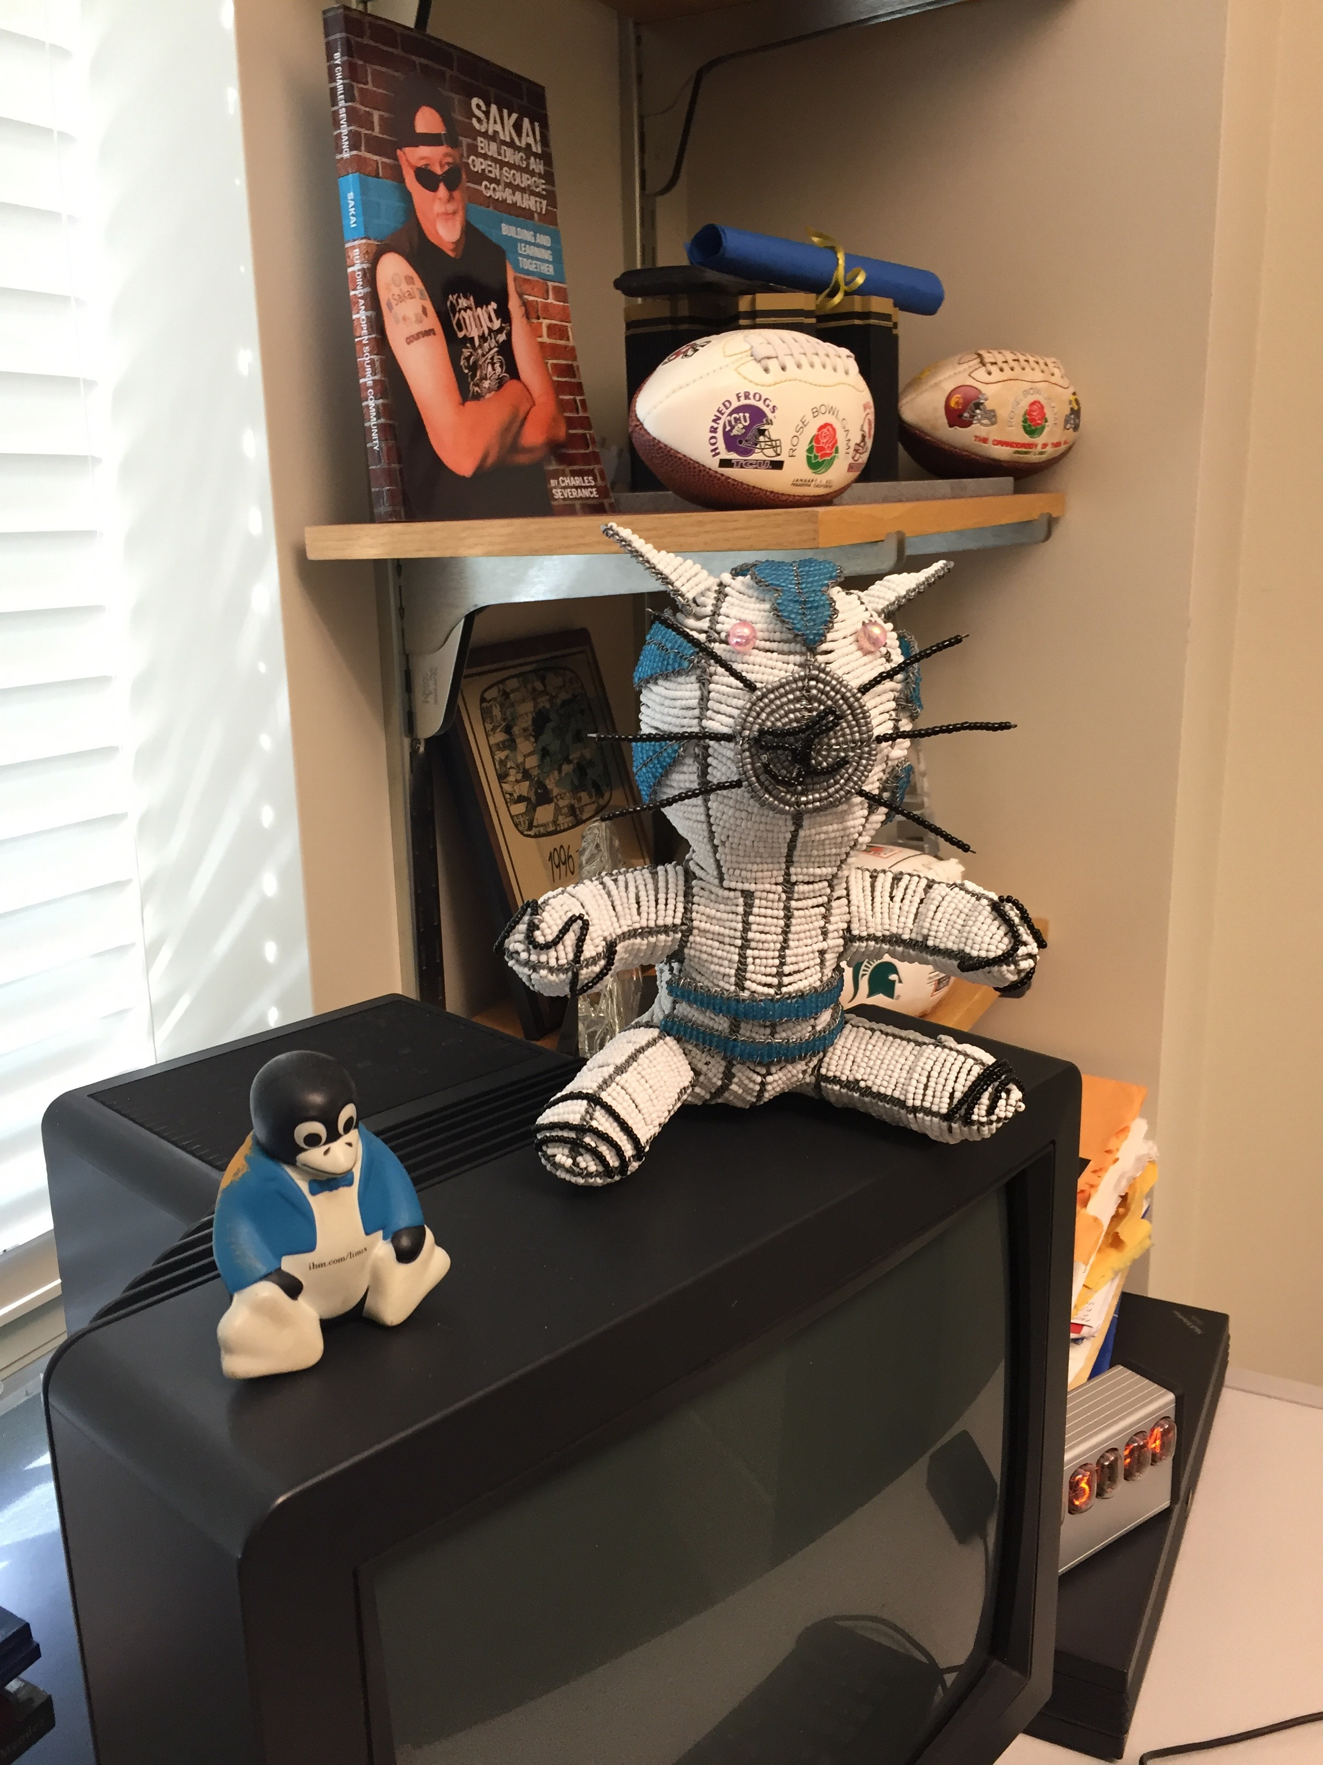

Slide 3
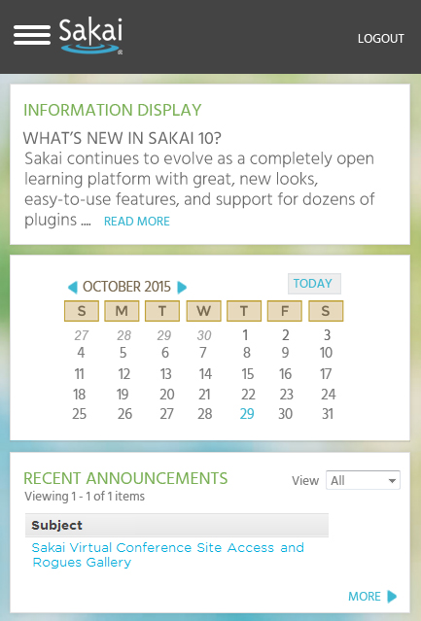
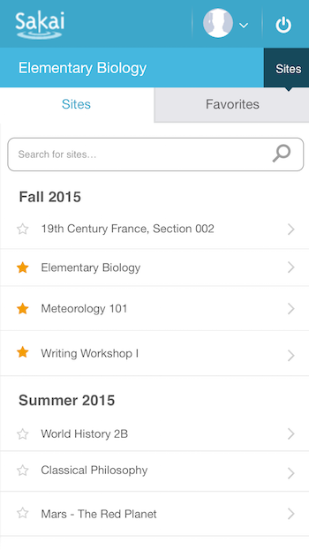
Sakai 11 – Pretty, Awesome. Responsive

Slide 4

Original Mission
Build a set of standards-based tool kits to greatly advance the state of the art of interoperability, reusability, and re-mixability for learning content and software.

Slide 5
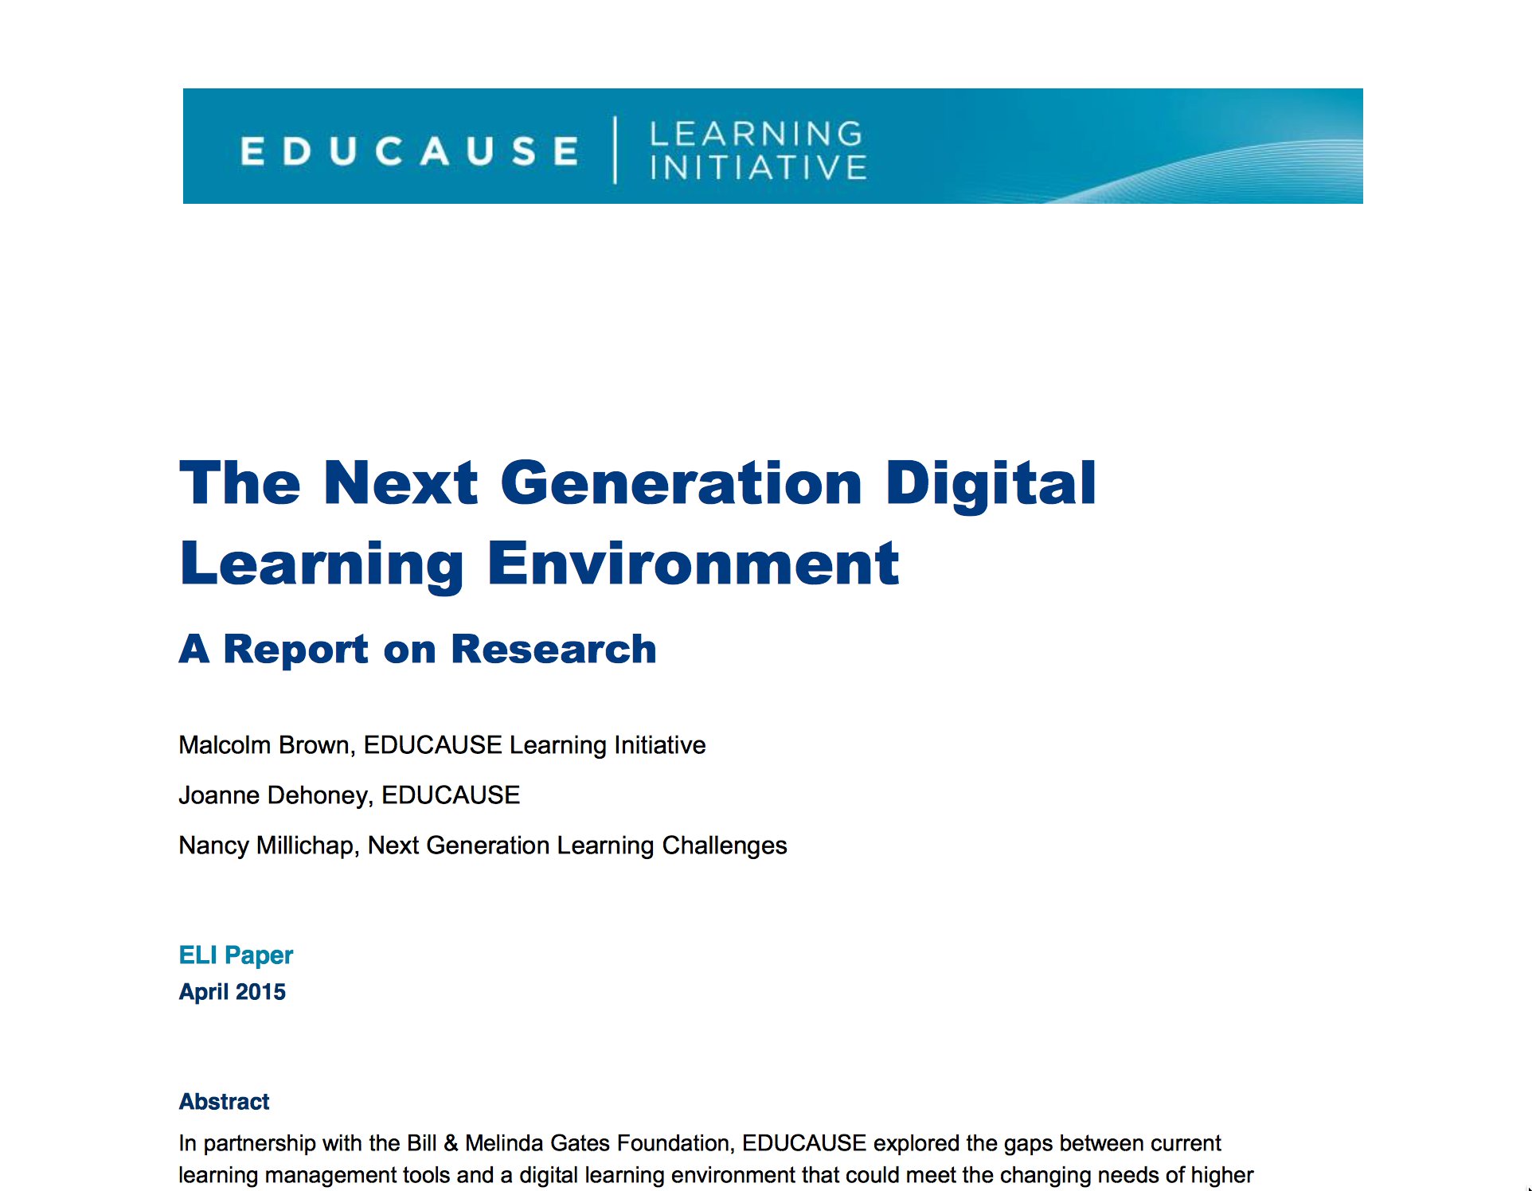
https://net.educause.edu/ir/library/pdf/eli3035.pdf

Slide 6
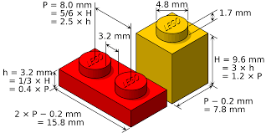
interoperability
Source: Malcolm Brown

Slide 7
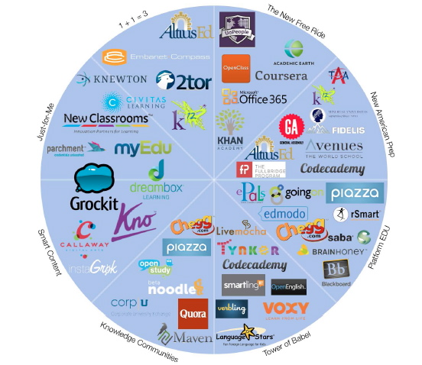
Historic
Levels of
Venture
Investment
in EdTech
Source: GSV: American
Revolution 2.0
http://gsvadvisors.com

Slide 8
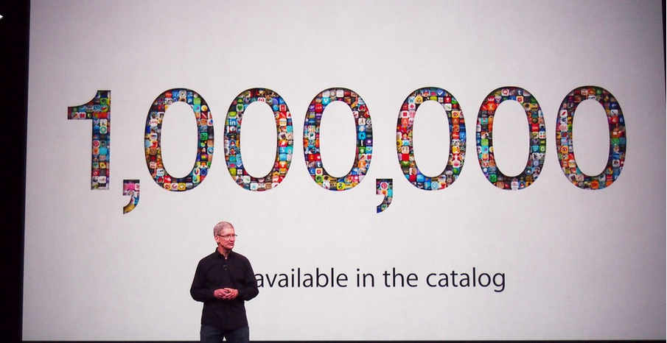
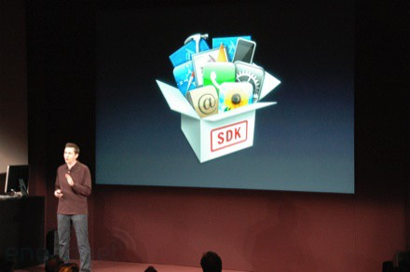
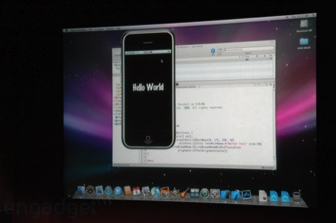
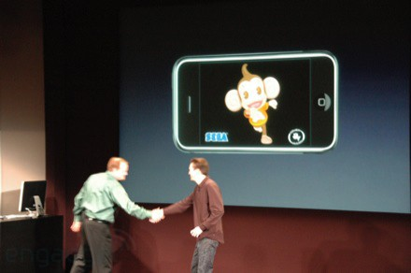
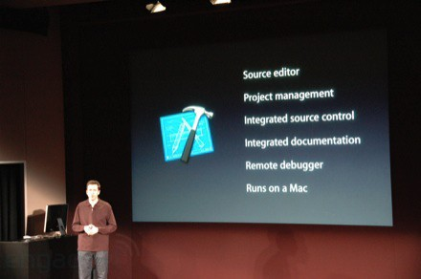
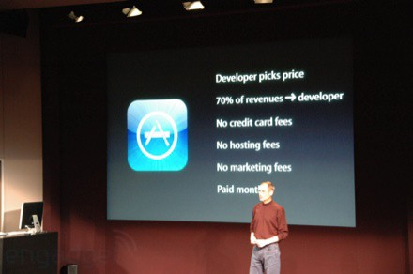
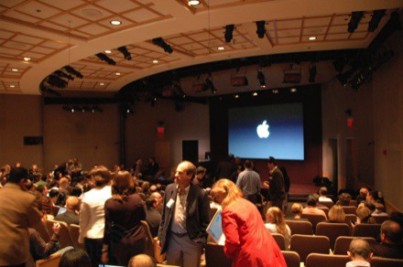
March 6, 2008 iPhone SDK Press Conference

Slide 9
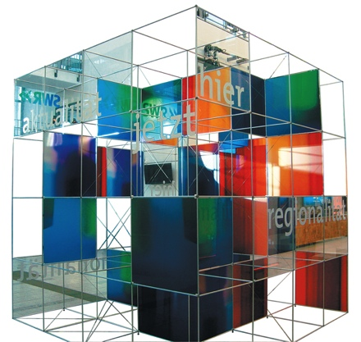
The Conclusion: The NGDLE is More Than an LMS
“An early conclusion from our research is that although the NGDLE might include a traditional LMS as a component, it will not itself be a single application like the current LMS or other enterprise applications. Rather, the NGDLE will be an ecosystem of sorts . . . “
https://net.educause.edu/ir/library/pdf/eli3035.pdf

Slide 10
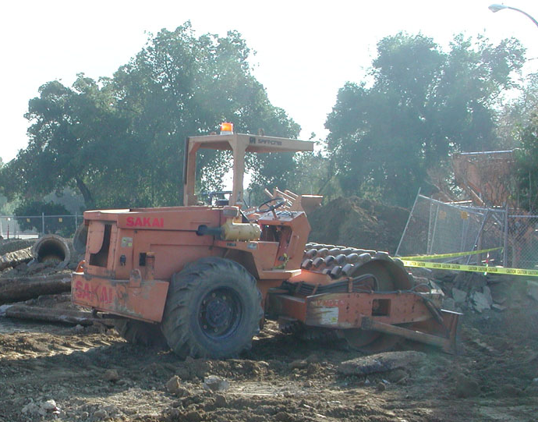


Getting to 100K Learning Applications
App Store Plumbing

Slide 11
What to Build
Rich Standards
Training for Developers
API Libraries – PHP, Java, Python, Node...
App Store for Learning Applications
Content Repositories
Learning Management Systems (many)

Slide 12

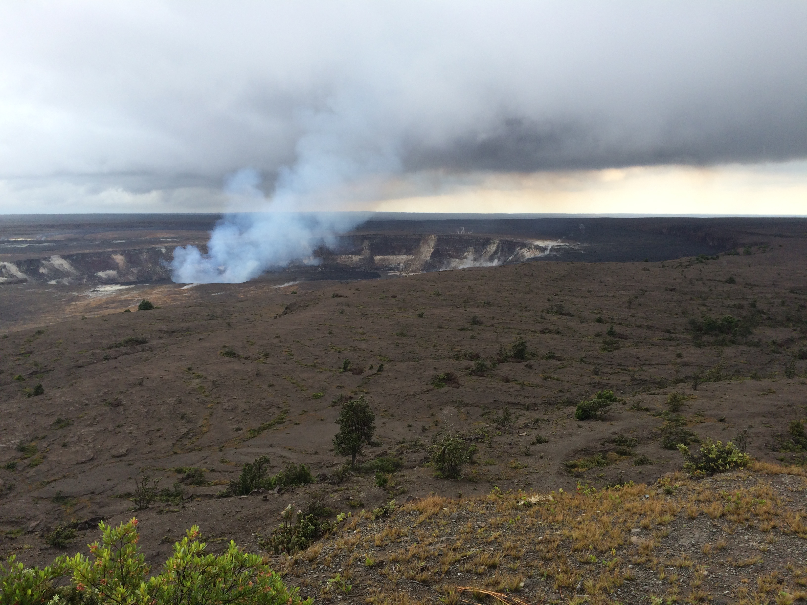
Expanding Standards
IMS Common Cartridge – 1.0, 1.1, 1.2, 1.3, 2.0
IMS Learning Tools Interoperability 1.0, 1.1, 2.0, 2.1, 2.2
IMS LTI Content Item - Public Draft
IMS LTI Roster Services – WG Draft
IMS LTI Outcomes Services – in WG Draft
IMS Caliper 1.0
IMS OneRoster – Rest-based SIS integration
IMS CASA App Store – WG – Draft
IMS CC / EPUB 3.0 Coordination

Slide 13
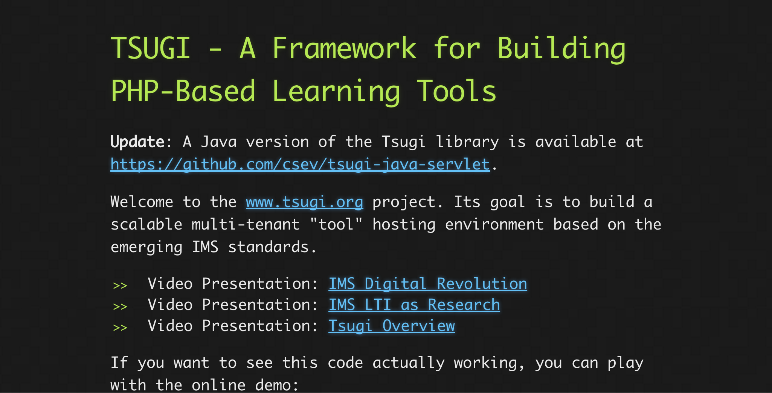
www.tsugi.org

Slide 14
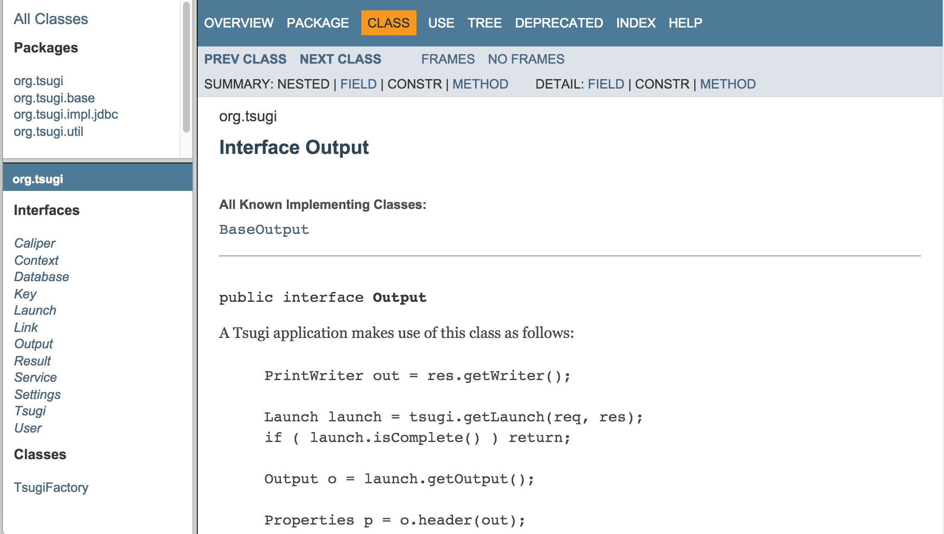
http://csev.github.io/tsugi-java/apidocs/index.html

Slide 15
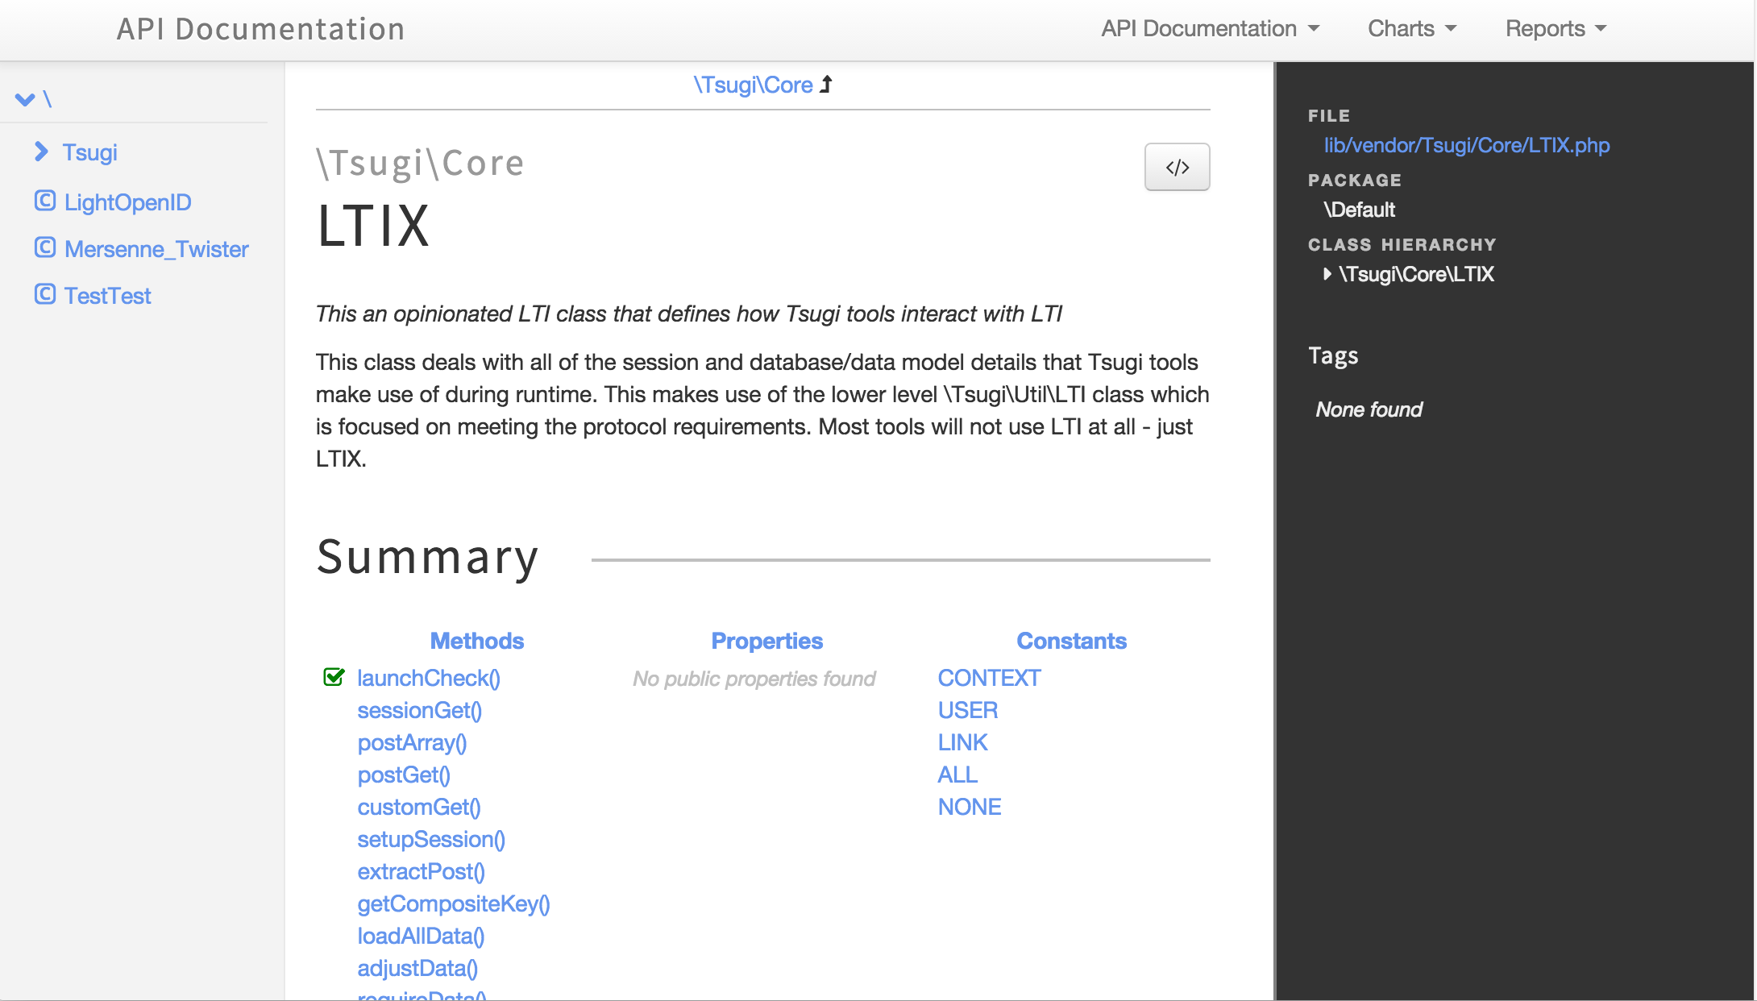
http://do1.dr-chuck.com/tsugi/phpdoc/classes/Tsugi.Core.LTIX.html

Slide 16
Tsugi Tools To Date
App Store
Google Class Map
GIFT Quiz Engine
Grade book
Attendance Tool
Video Tracker (*)
Clicker (*)
HTML5 Autograder
Python Autograder
SQL Autograder
DataMining Autograder
PHP Autograder
https://lti-tools.dr-chuck.com/tsugi Developer -> "secret"

Slide 17
Tsugi Developer Training
PHP / MySQL – www.php-intro.com
Tsugi Recorded Lecture Series
http://lectures.tsugi.org/
Lots of sample code
Assignments for Developer Workshop
Grade, Chat, Map, Wisdom of Crowds

Slide 18
Tsugi Production
Auto grading and peer grading for Coursera
pr4e.dr-chuck.com – 214353 user accounts
On campus Sakai/Canvas/Blackboard and demo accounts
lti-tools.dr-chuck.com
My own free course service
online.dr-chuck.com
Static assets on CloudFlare CDN
https://www.dr-chuck.net/tsugi

Slide 19
IMS Content Item and CASA
One of Many of the upcoming new Specicifations

Slide 20
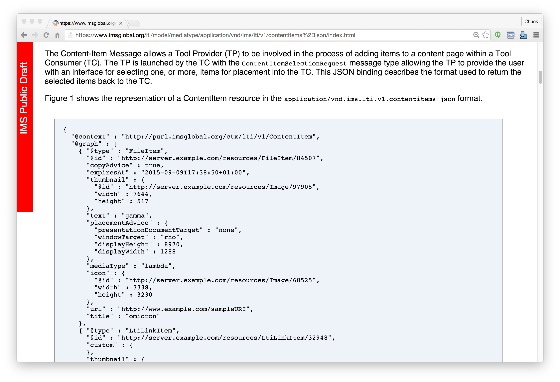
IMS
Content
Item
https://www.imsglobal.org/specs/lticiv1p0

Slide 21

IMS Content Item Launch
APP
LMS
Launch Picker
APP
APP
Launch Picker
Content
Repository

Slide 22
IMS Content Item Return
APP
LMS
APP
APP
APP
URL, Configuration
Content
Repository
IMS Common
Cartridge (ZIP File)

Slide 23
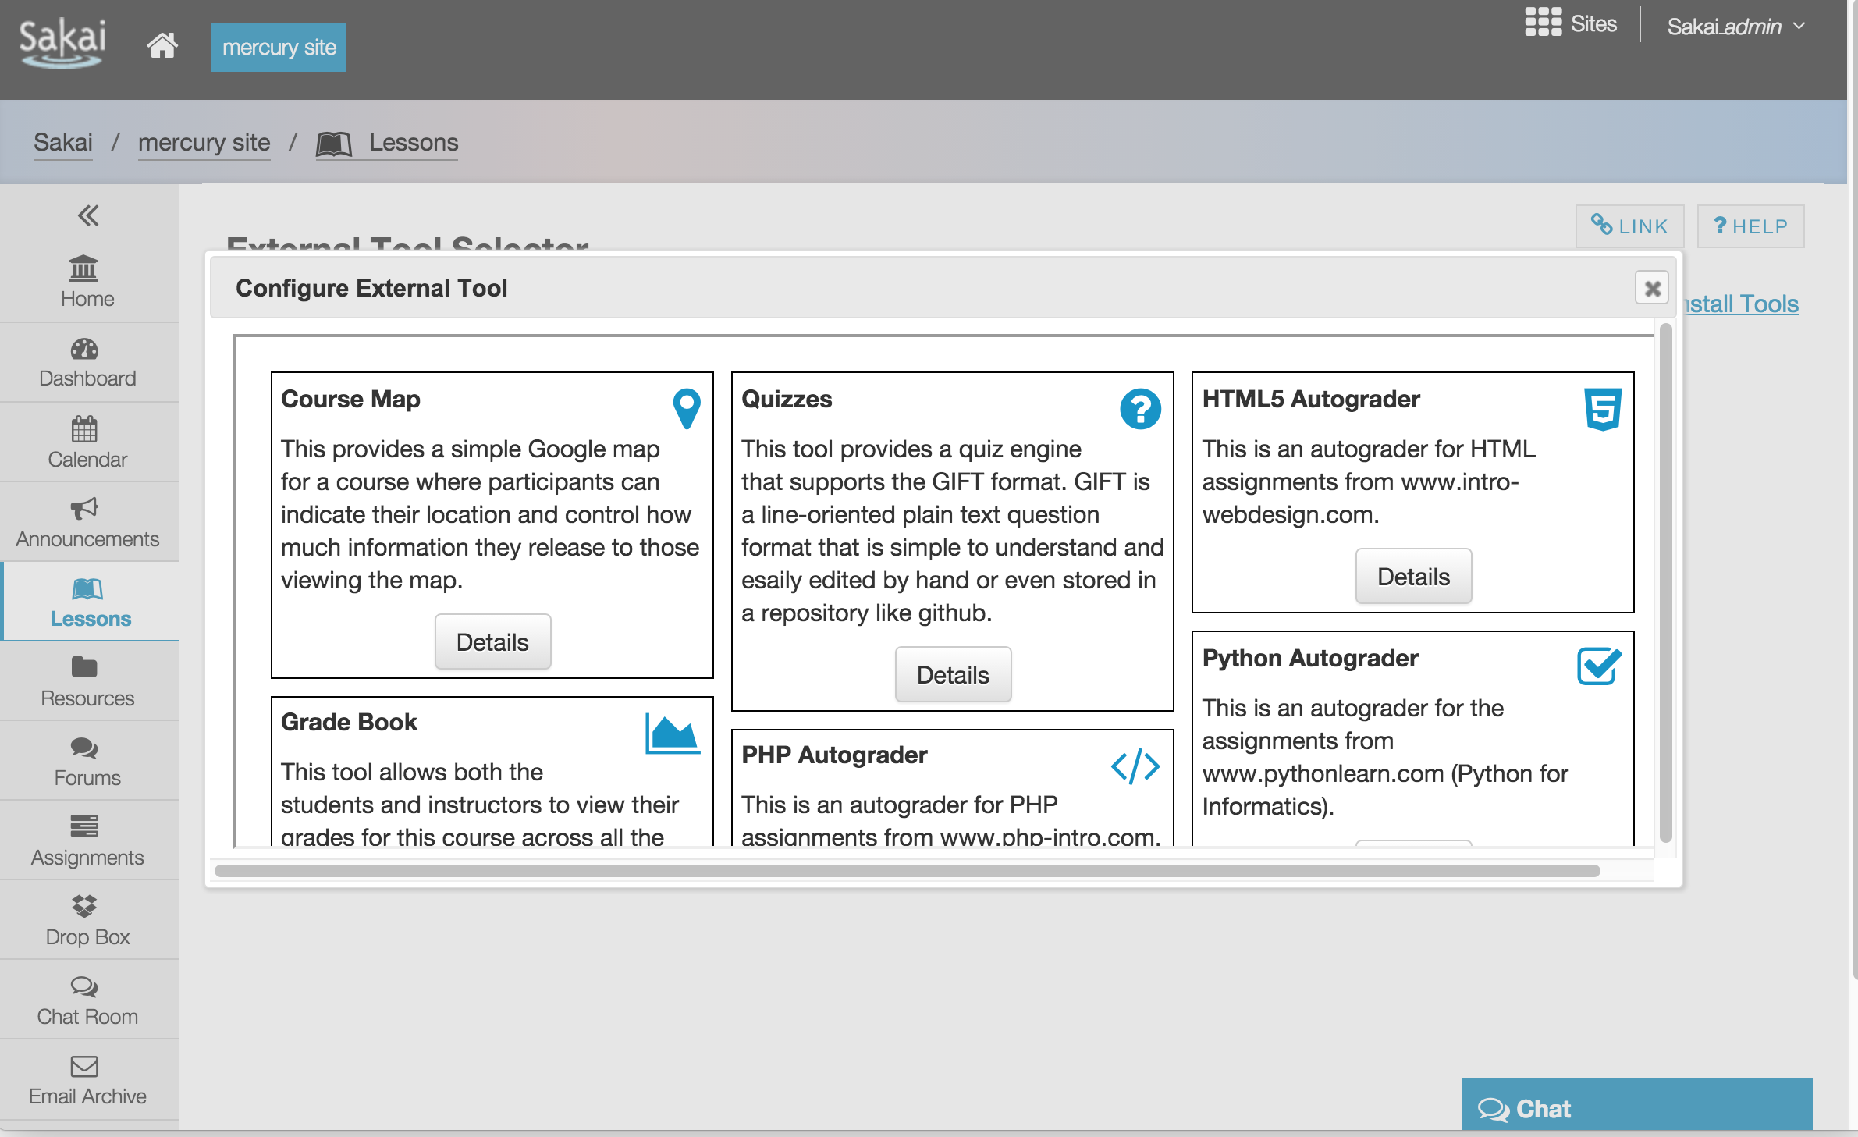

Slide 24
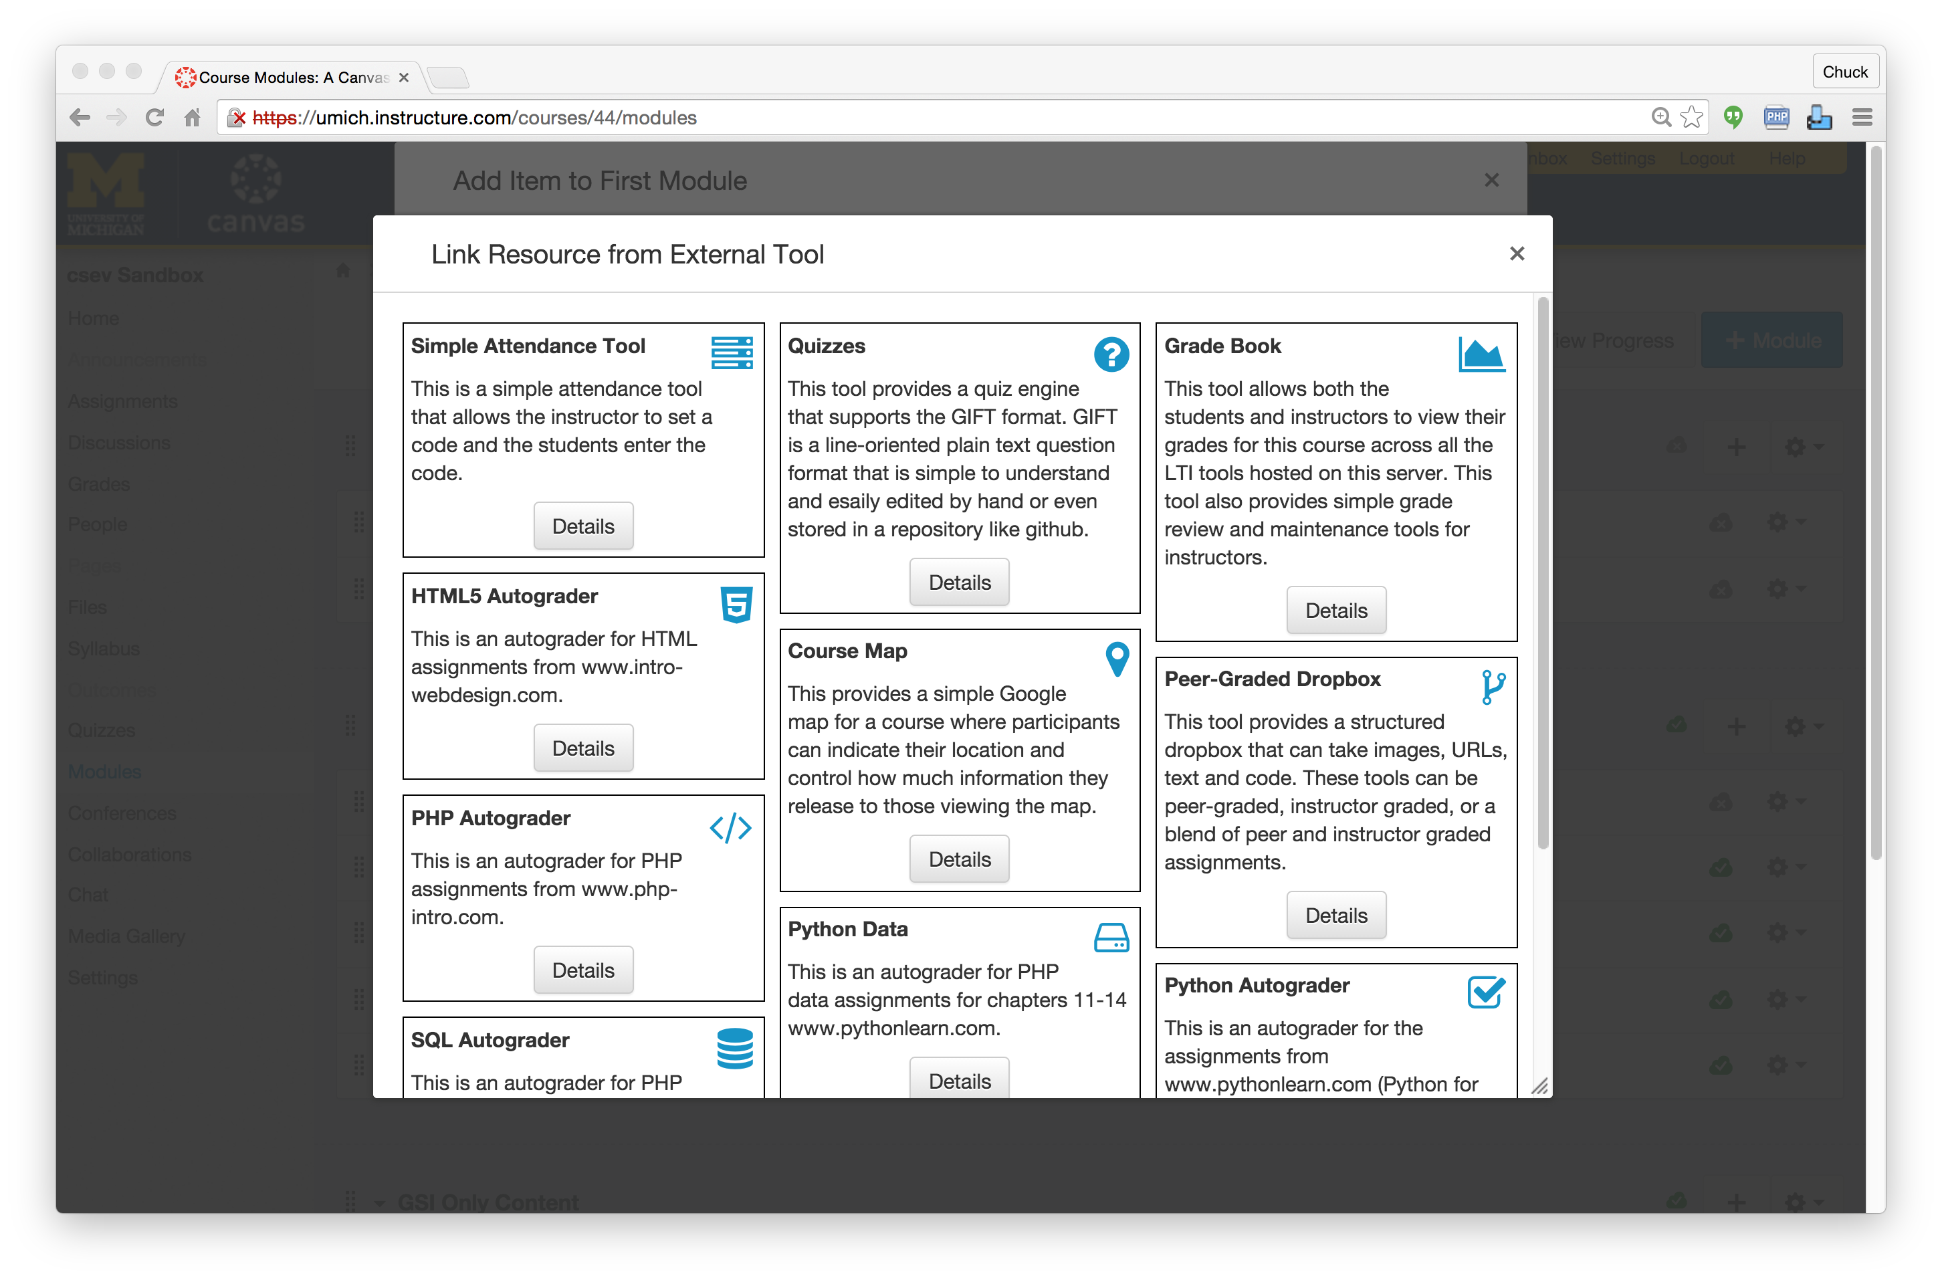

Slide 25
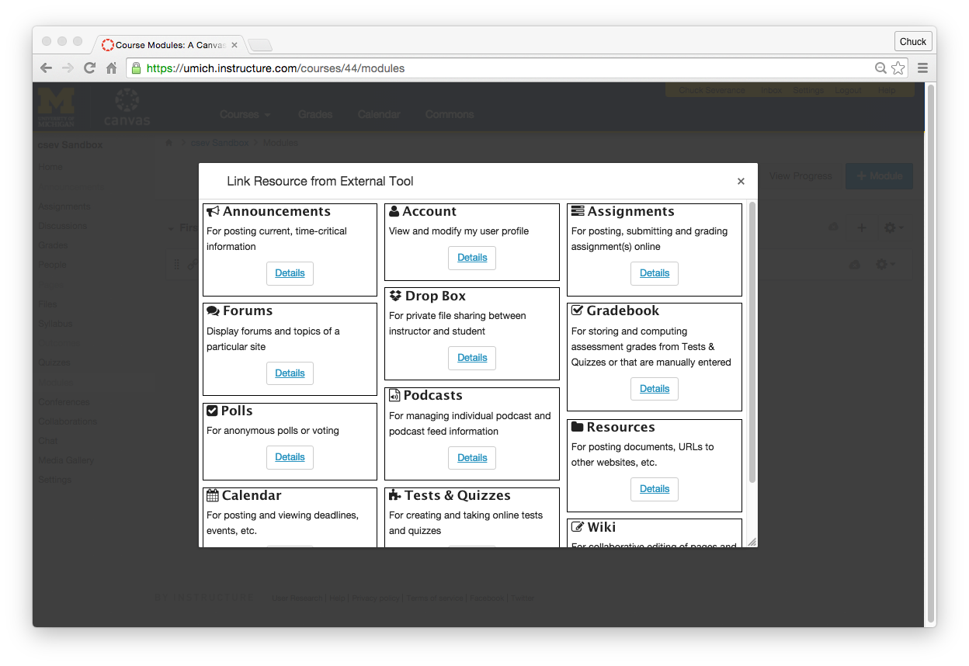

Slide 26
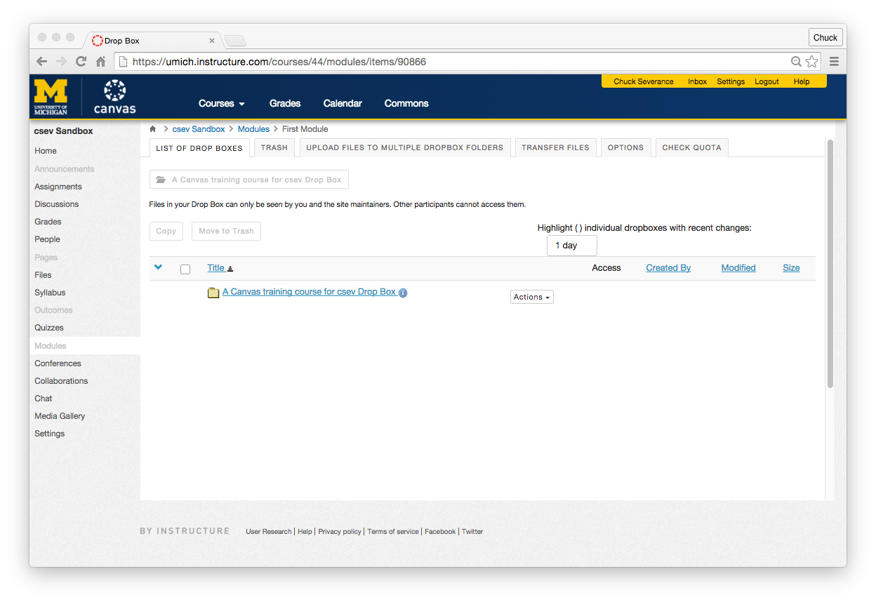

Slide 28
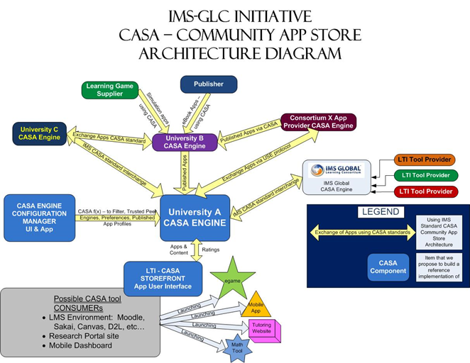

Slide 29
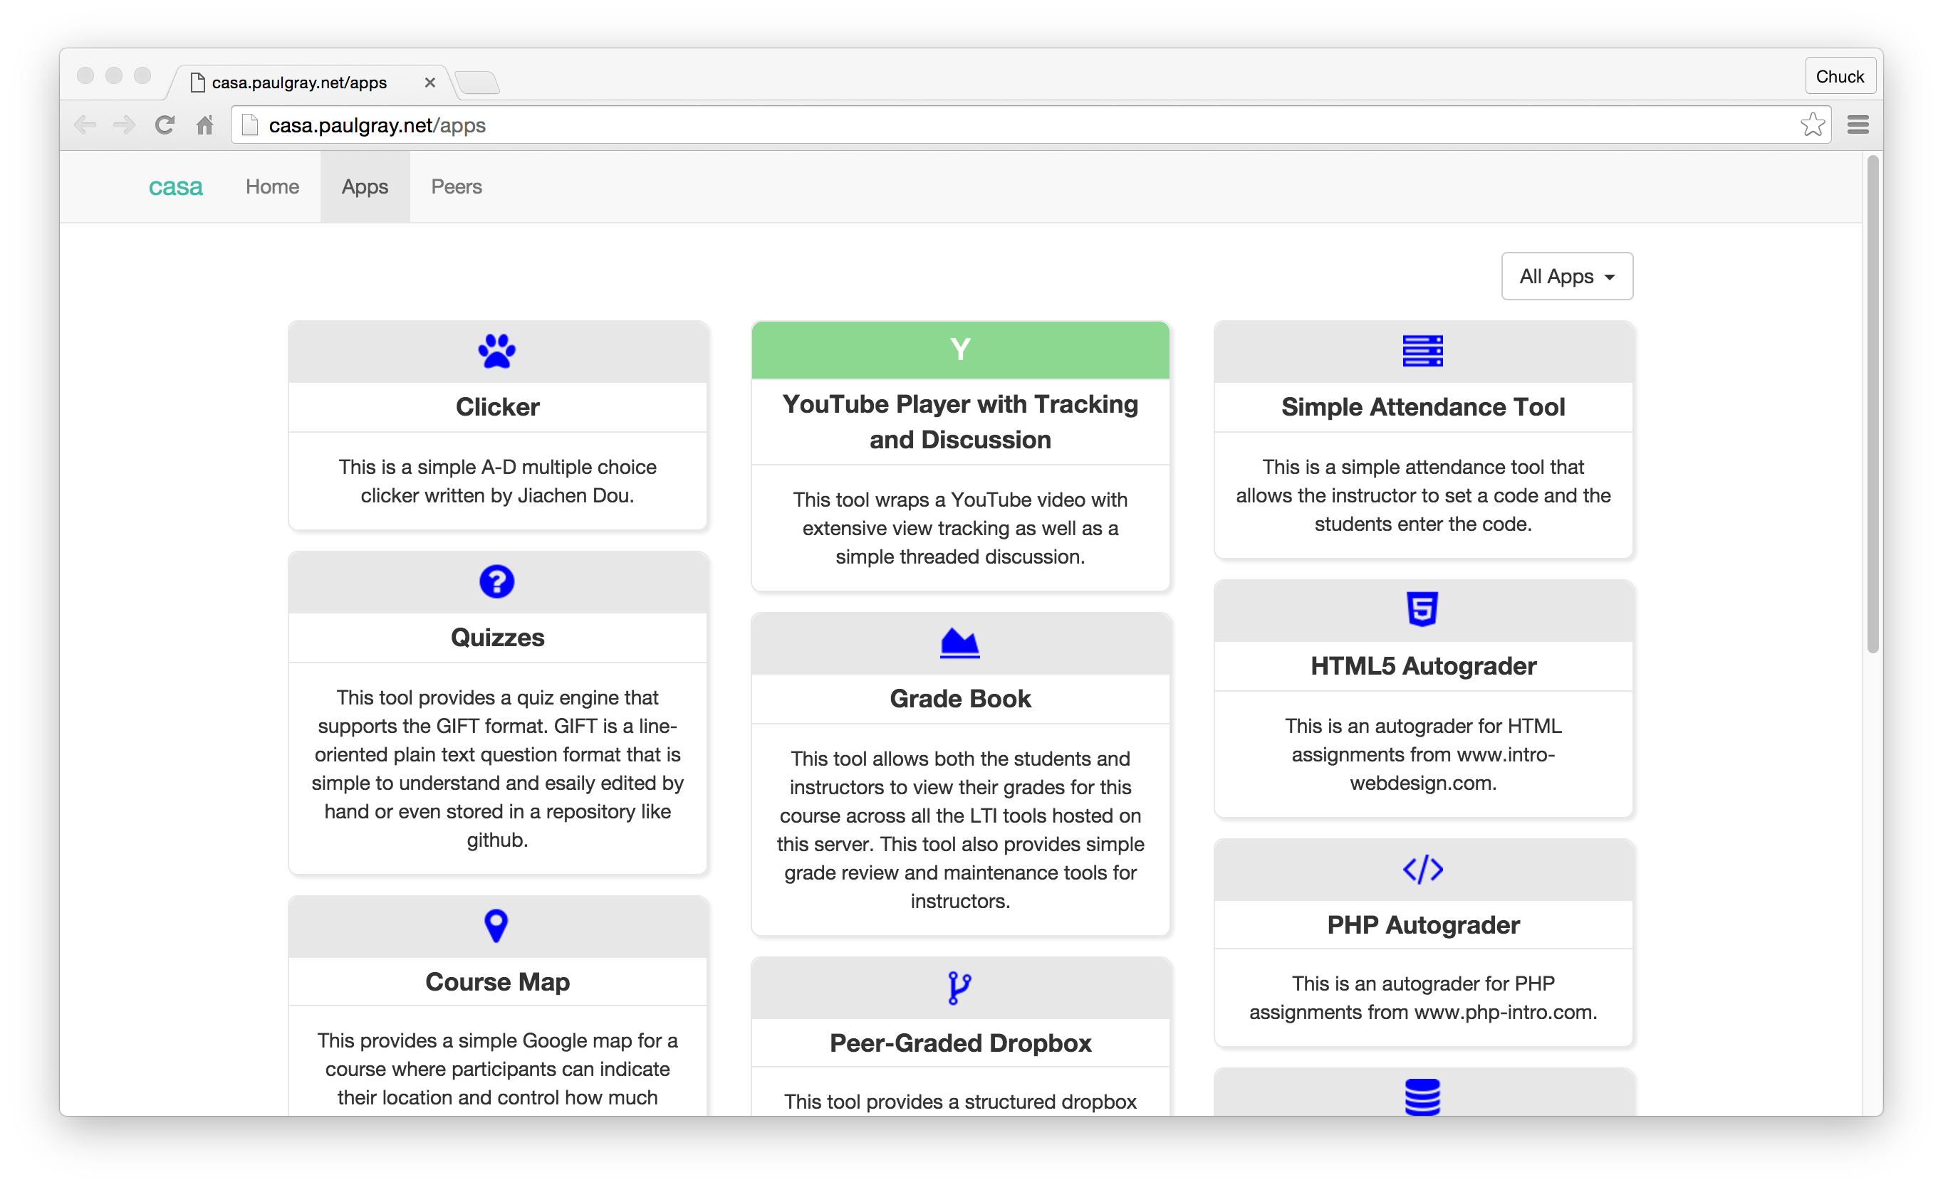

Slide 30
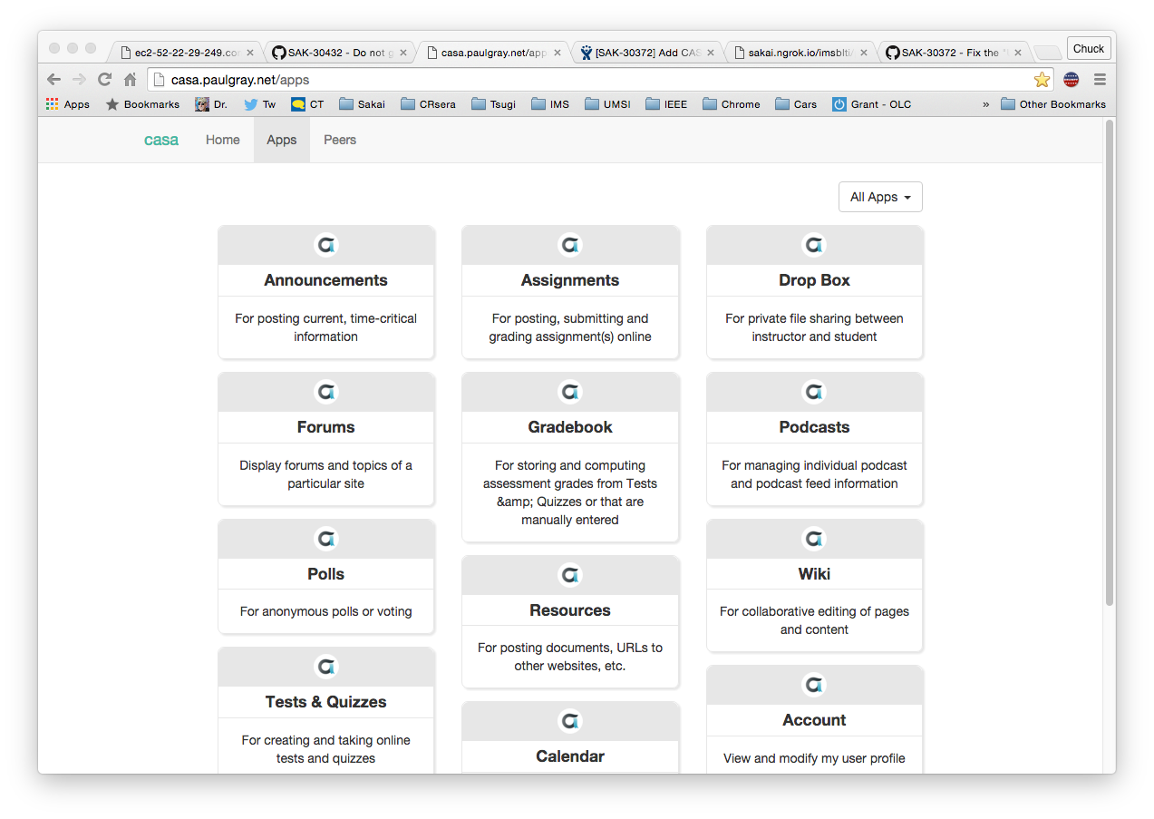

Slide 31
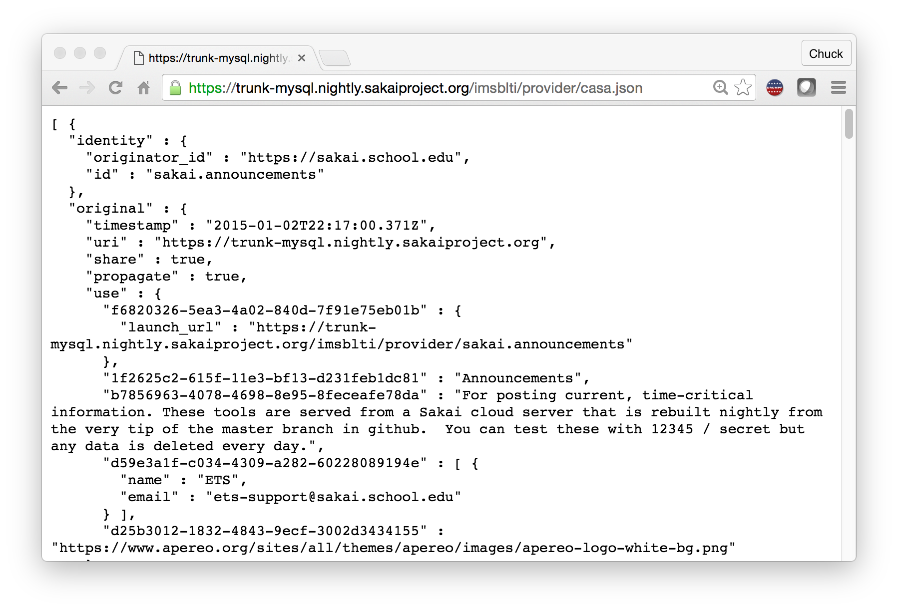

Slide 32

CASA
App Store
IMS CASA
IMS ContentItem

Slide 33
Standards Score Card
LMS | LTI 1.x | Content Item | LTI 2.x | CASA
Canvas | A | A | B+
Sakai | A | A- | A- | B
Moodle | A | B-
D2L | A
Blackboard | A
Tsugi | A+ | A | A+ | B

Slide 34
In the Future
There will be many specialized LMSs with limited built in features
Most features come from app stores (also plentiful)
Book, web site, and course authoring will merge
Content will play in many different LMS systems
App stores will have > 100K apps / content
There will be business models beyond CIO to vendor
Teacher to vendor / Teacher to teacher / Student to vendor

Slide 35
NGDLE Experiments...
Repositories
Blackboard xpLor
Canvas Commons
App Store:
Canvas EduAppCenter
ELMS Network – Drupal + LTI Provider
Tsugi – www.tsugi.org
Small LMS + App Store + Marketed t to Teacher
Edmodo – App Store not LTI
Schoology – App Store with LTI

Slide 36
When?
A (lucky) Teacher's Perspective

Slide 37
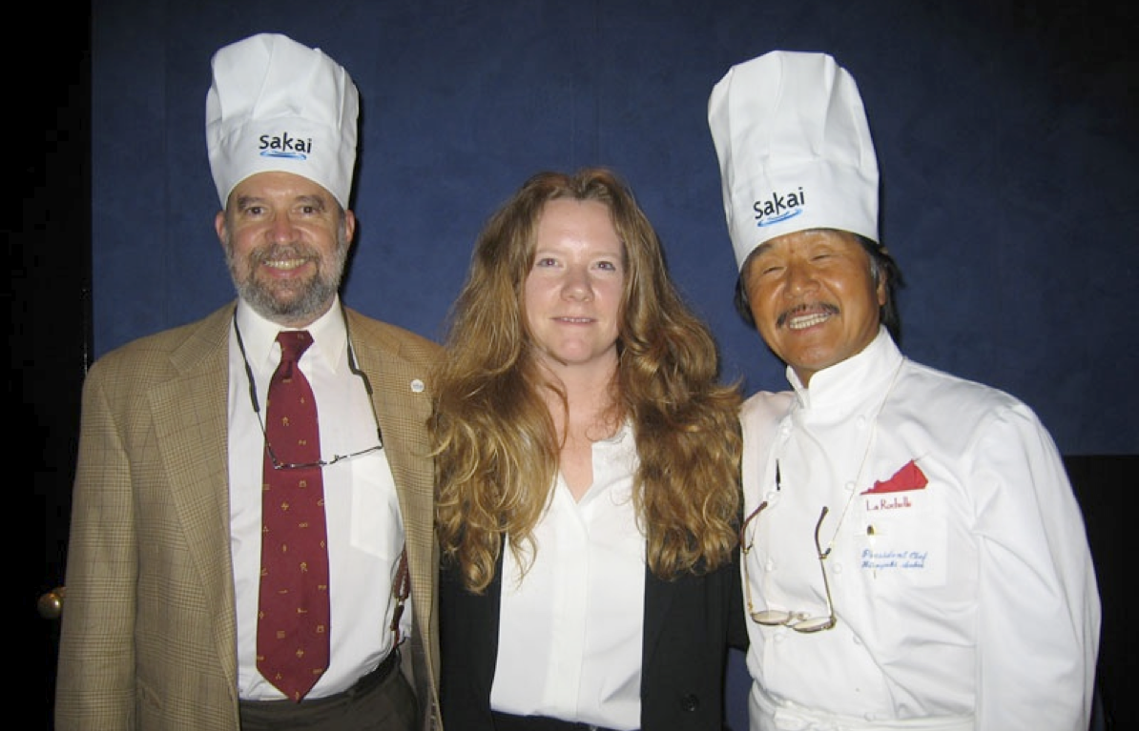
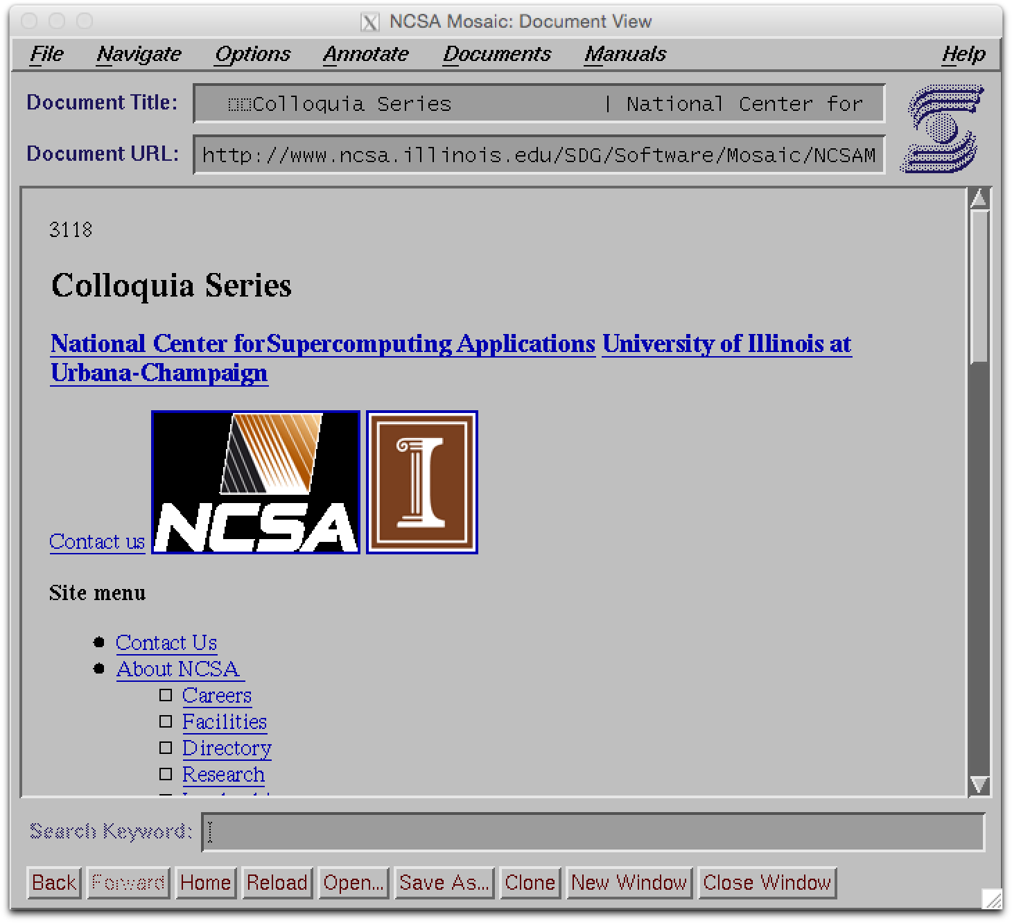
NCSA Mosaic
Joseph Hardin, Susan Hardin, Hirouki Sakai

Slide 38
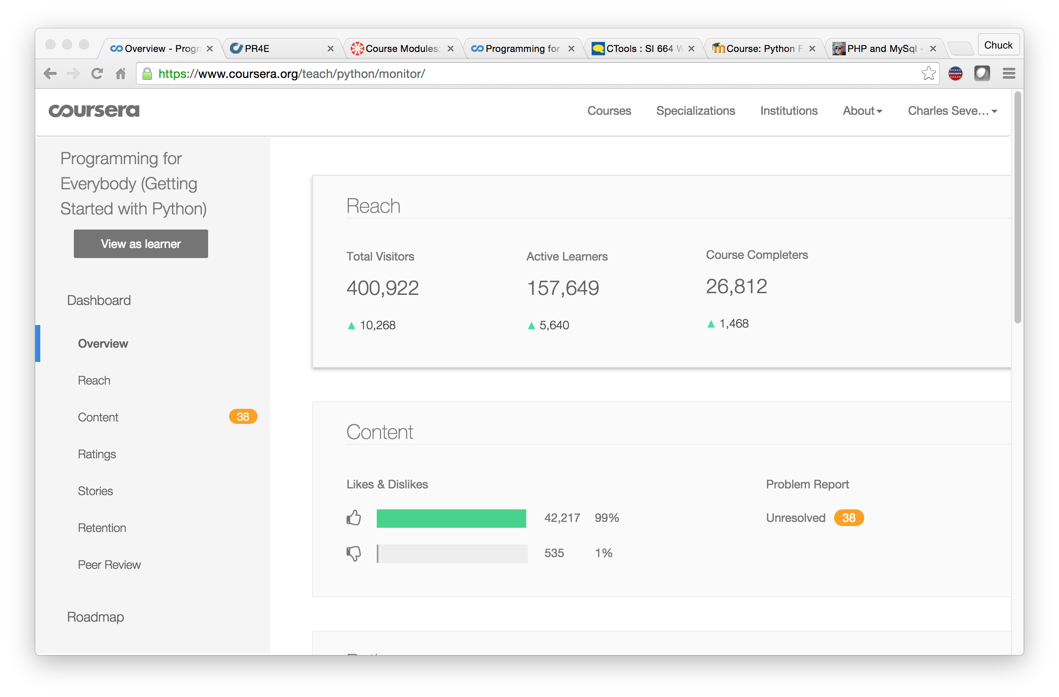

Slide 39
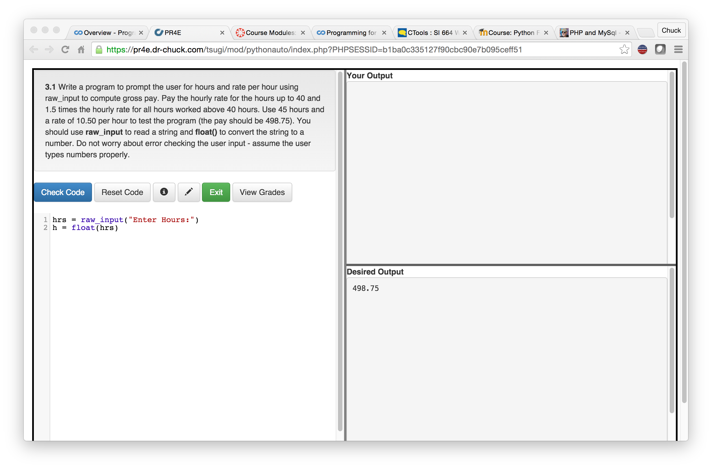

Slide 40
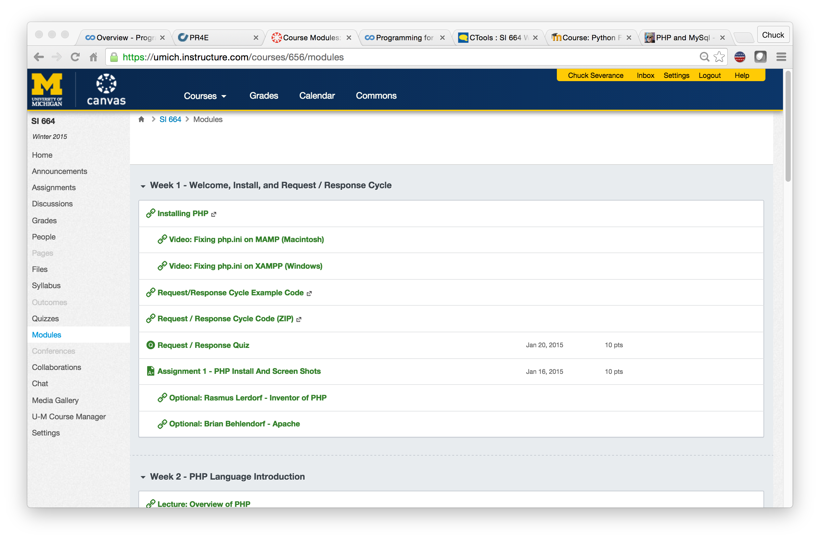

Slide 41
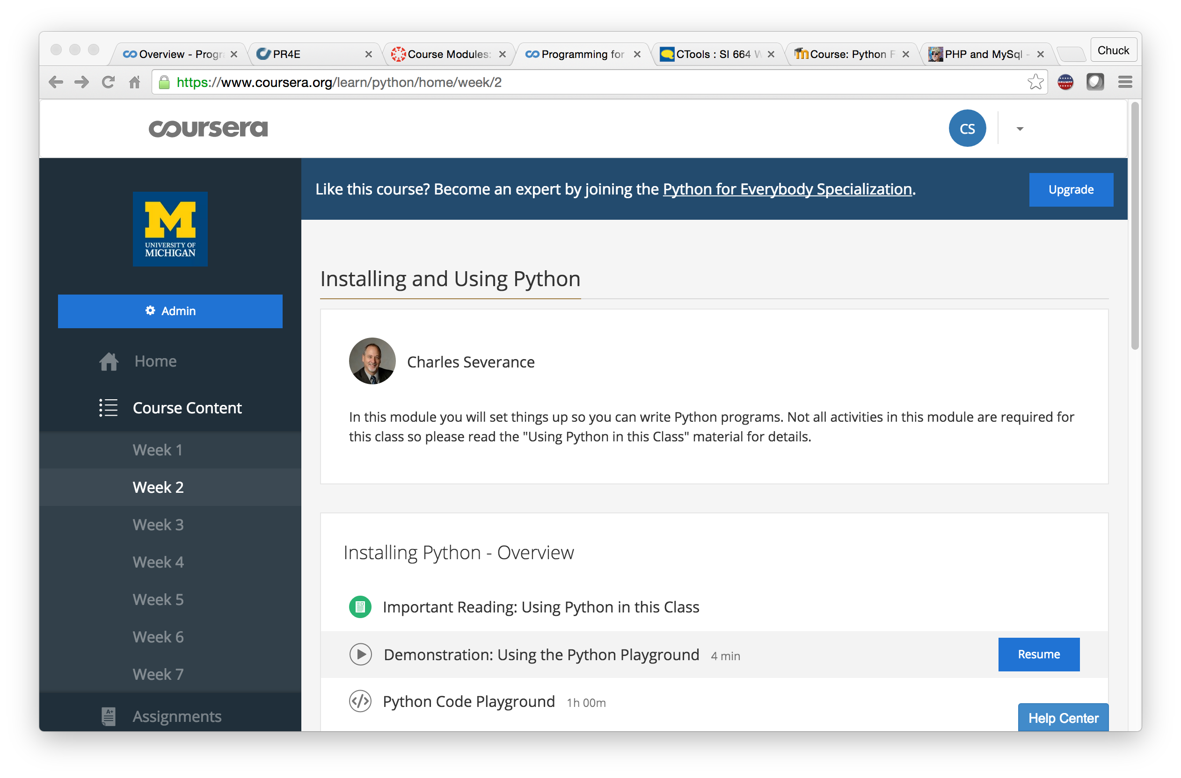

Slide 42
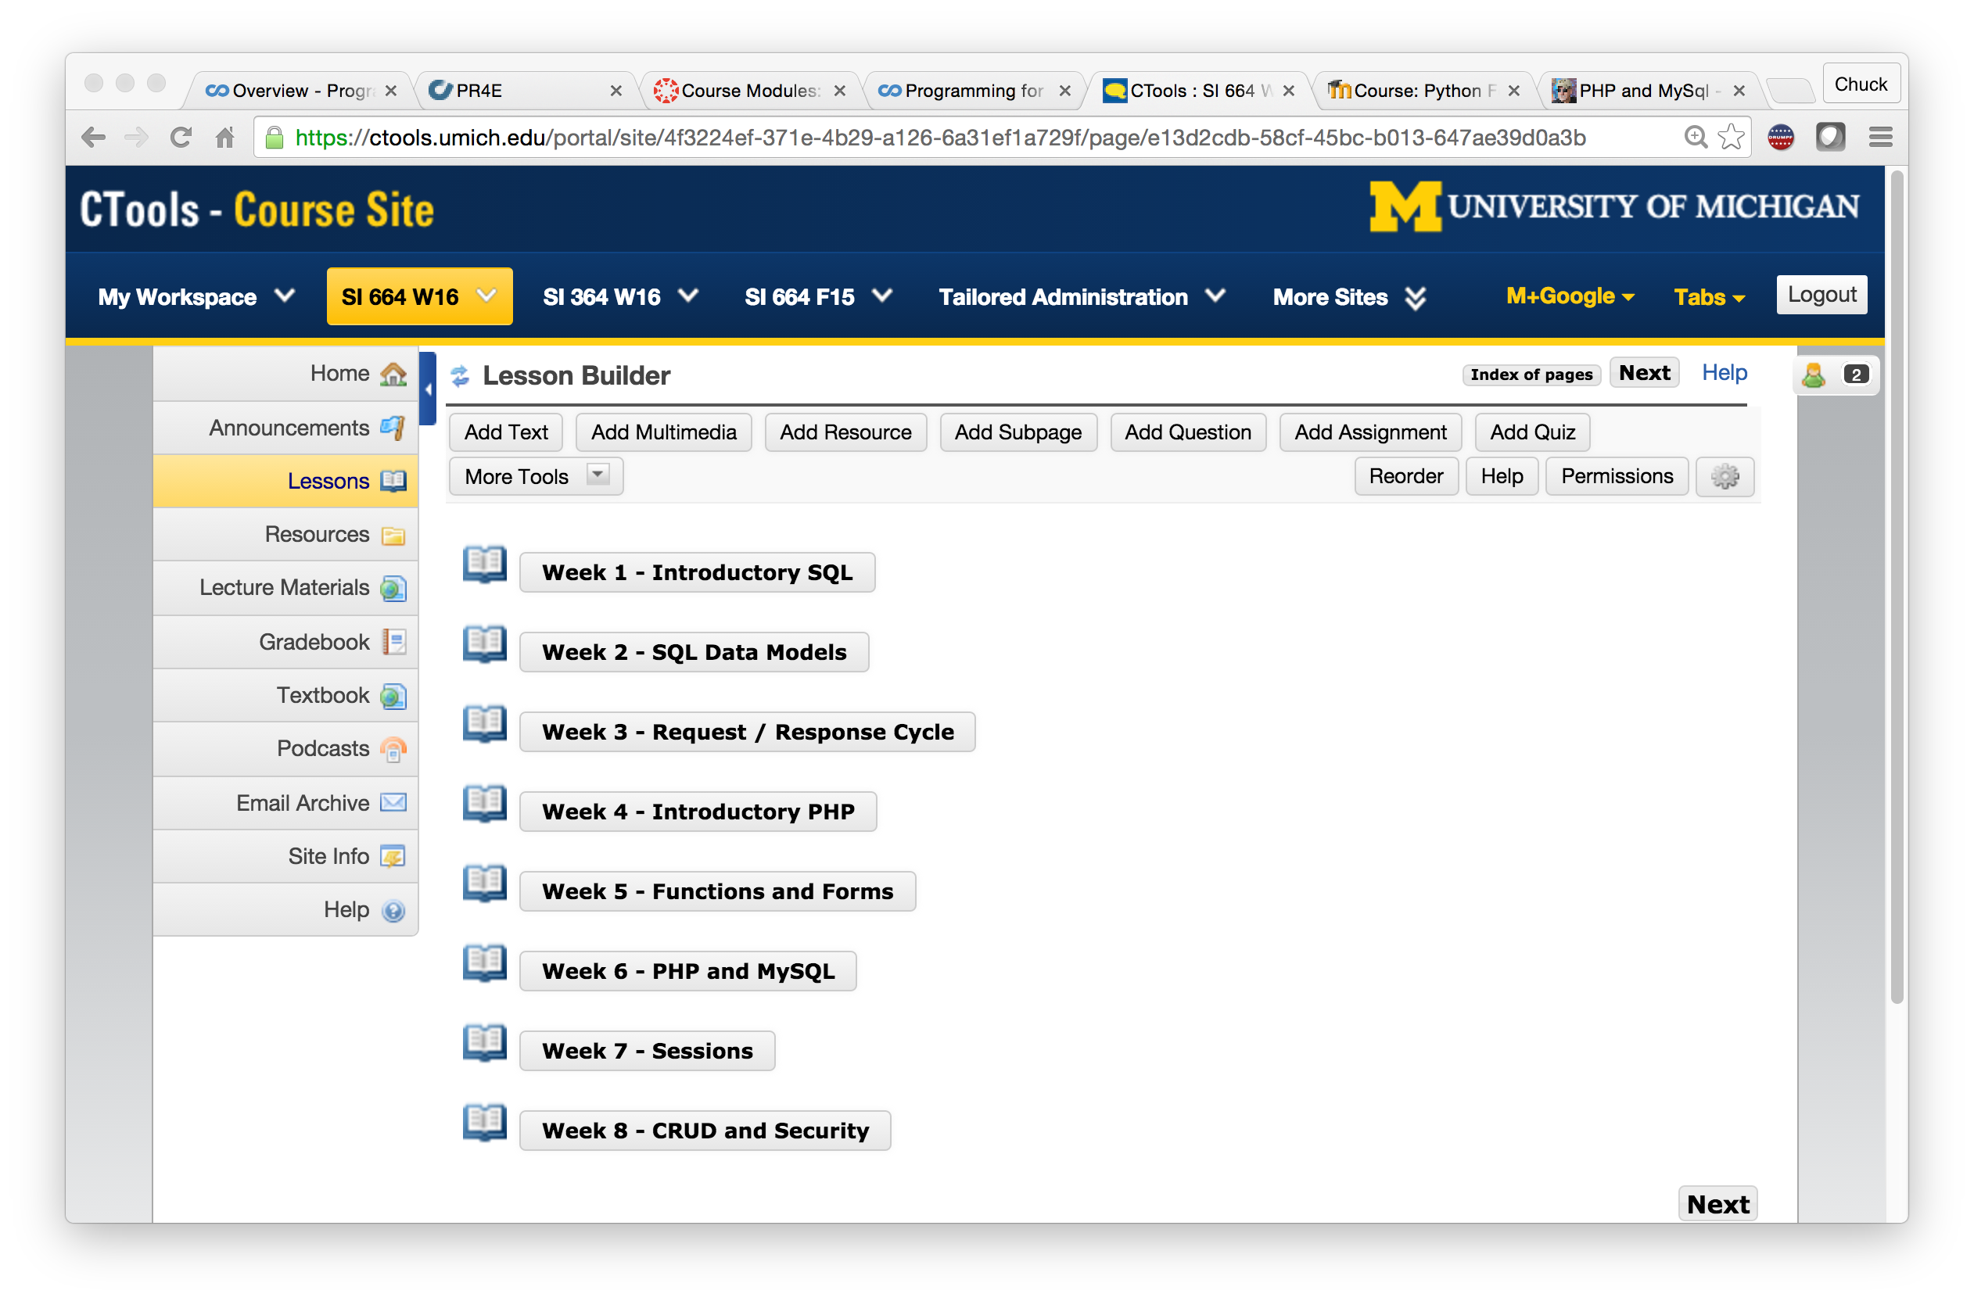

Slide 43
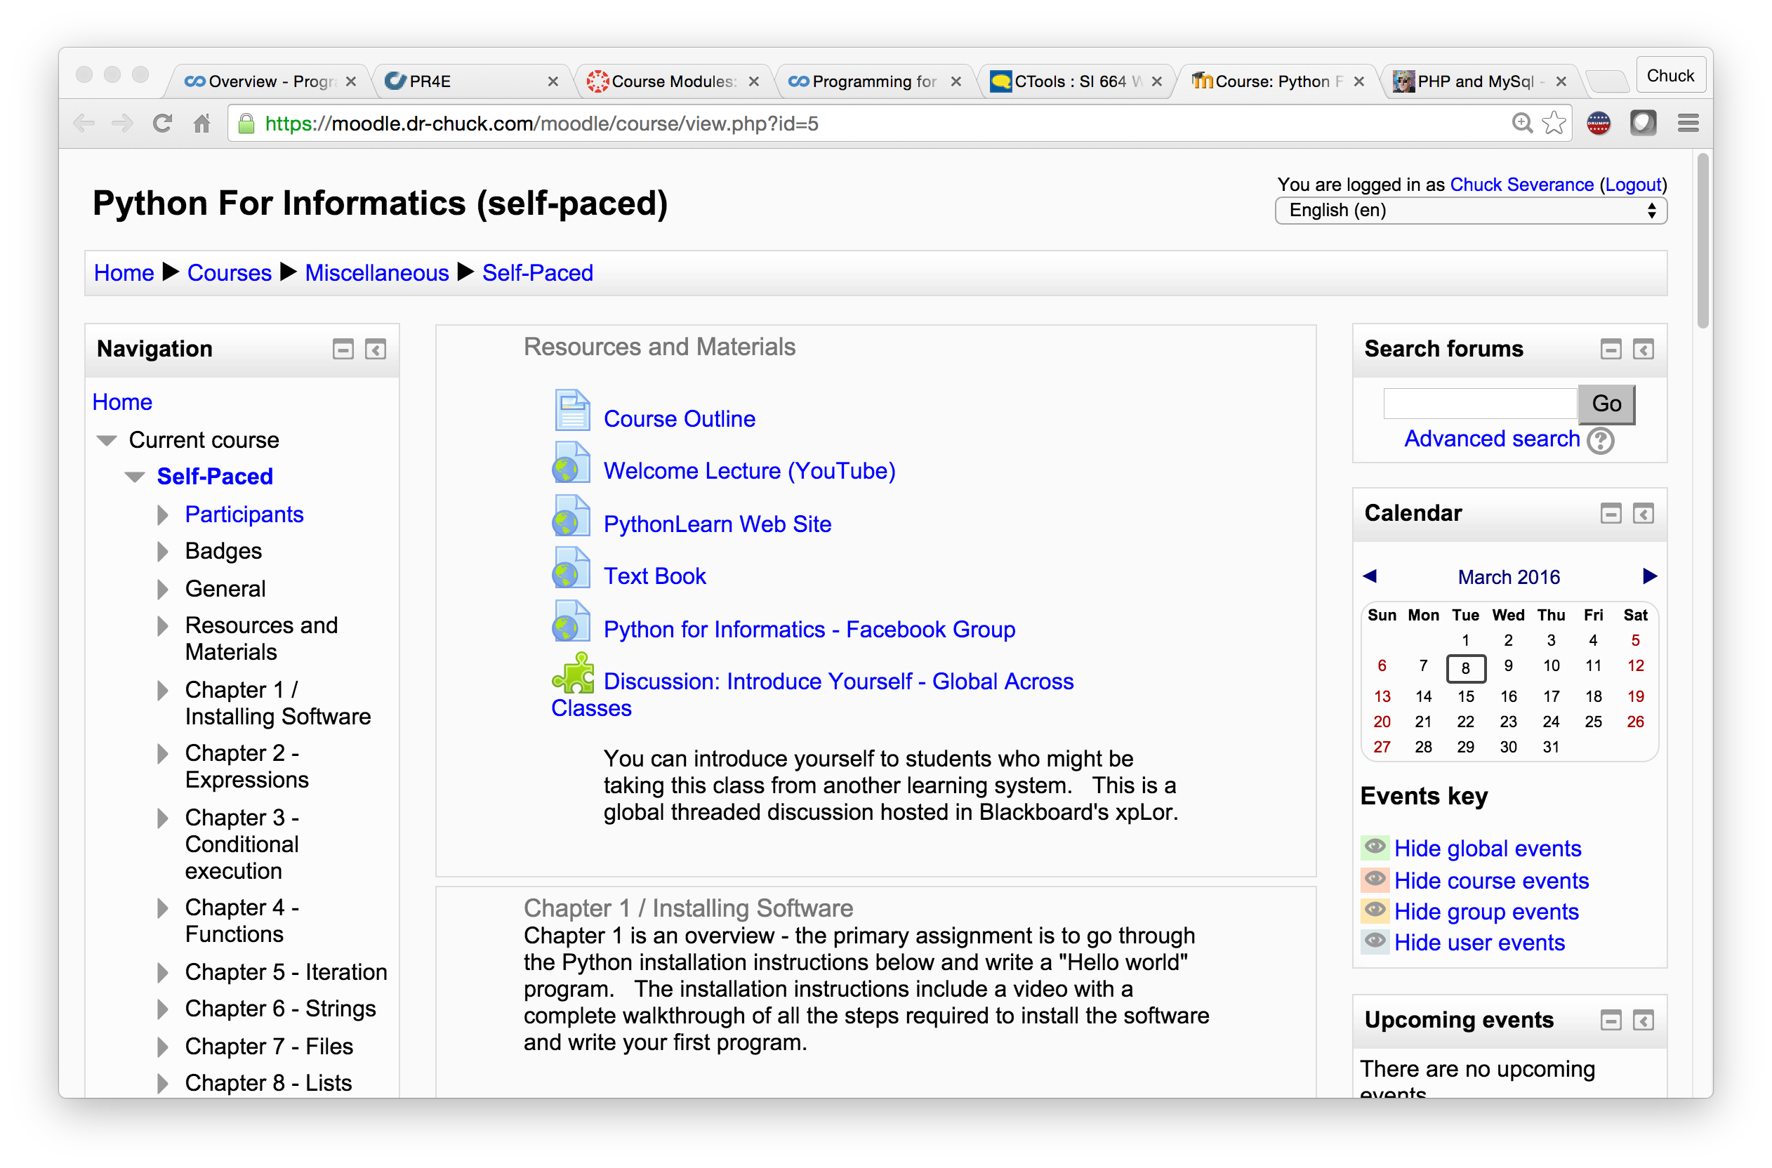

Slide 44
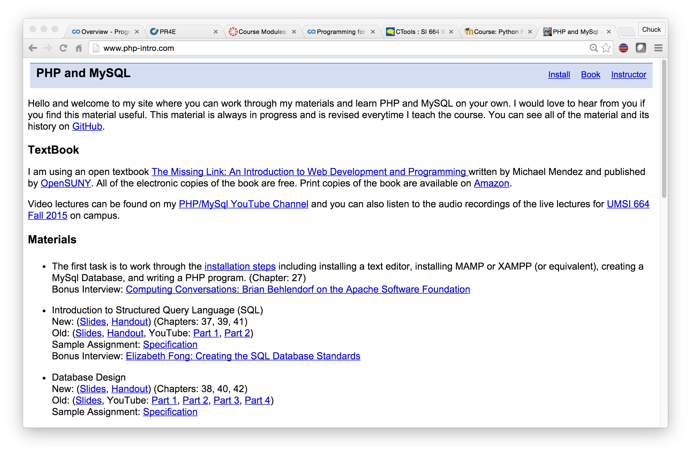

Slide 46
The Conclusion: The NGDLE is More Than an LMS
“An early conclusion from our research is that although the NGDLE might include a traditional LMS as a component, it will not itself be a single application like the current LMS or other enterprise applications. Rather, the NGDLE will be an ecosystem of sorts . . . “
https://net.educause.edu/ir/library/pdf/eli3035.pdf

Slide 47
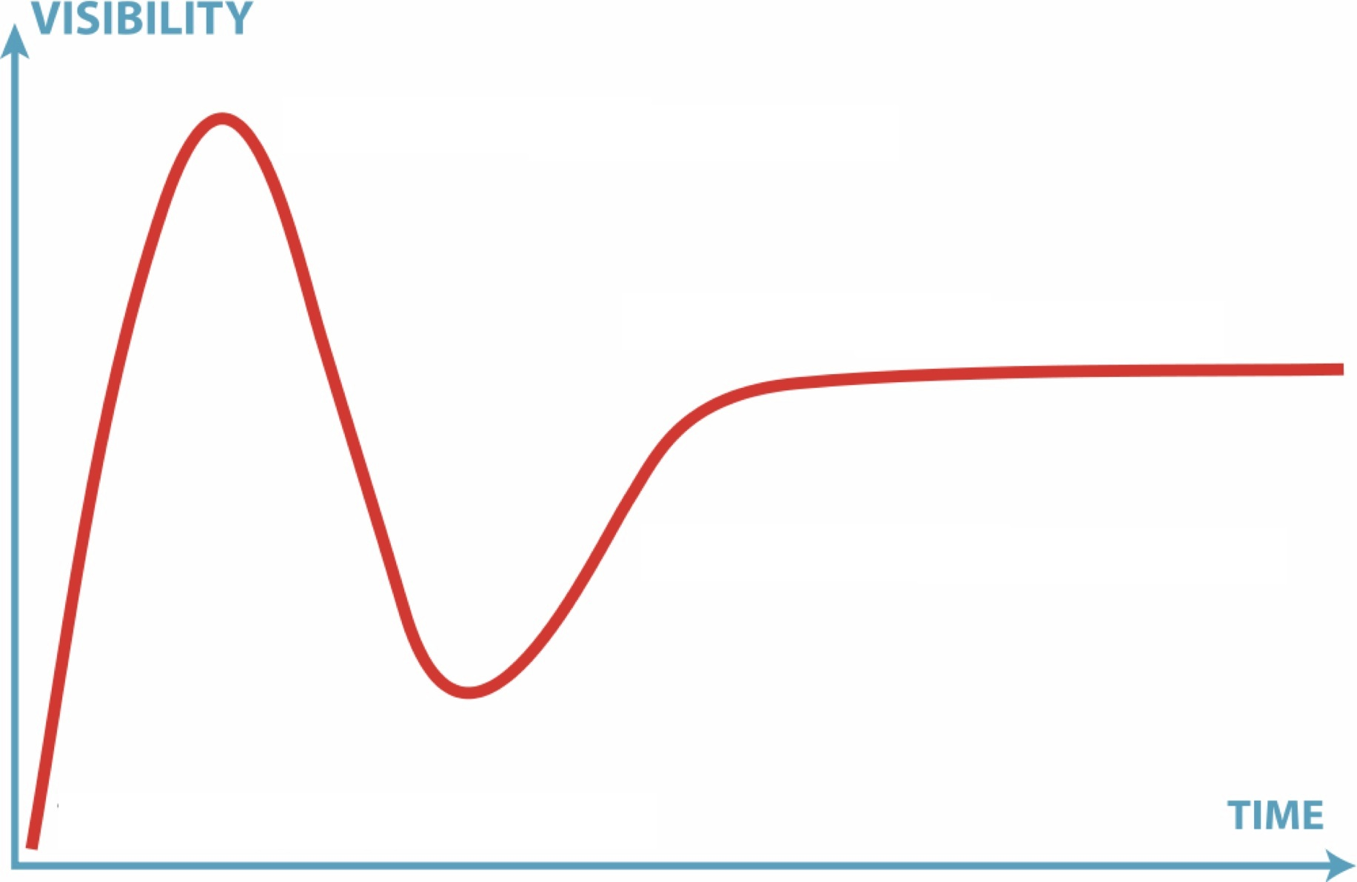

11
2.9
10
2.6
2.7
2.8
2.5
2.0
1.0
1.5

Slide 48
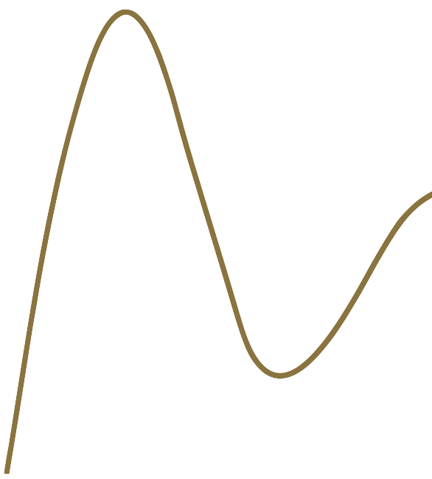
11
2.9
10
2.6
2.7
2.8
2.5
2.0
1.0
1.5

Slide 49
12
11
2.9
10
2.6
2.7
2.8
2.5
2.0
1.0
1.5

Slide 50
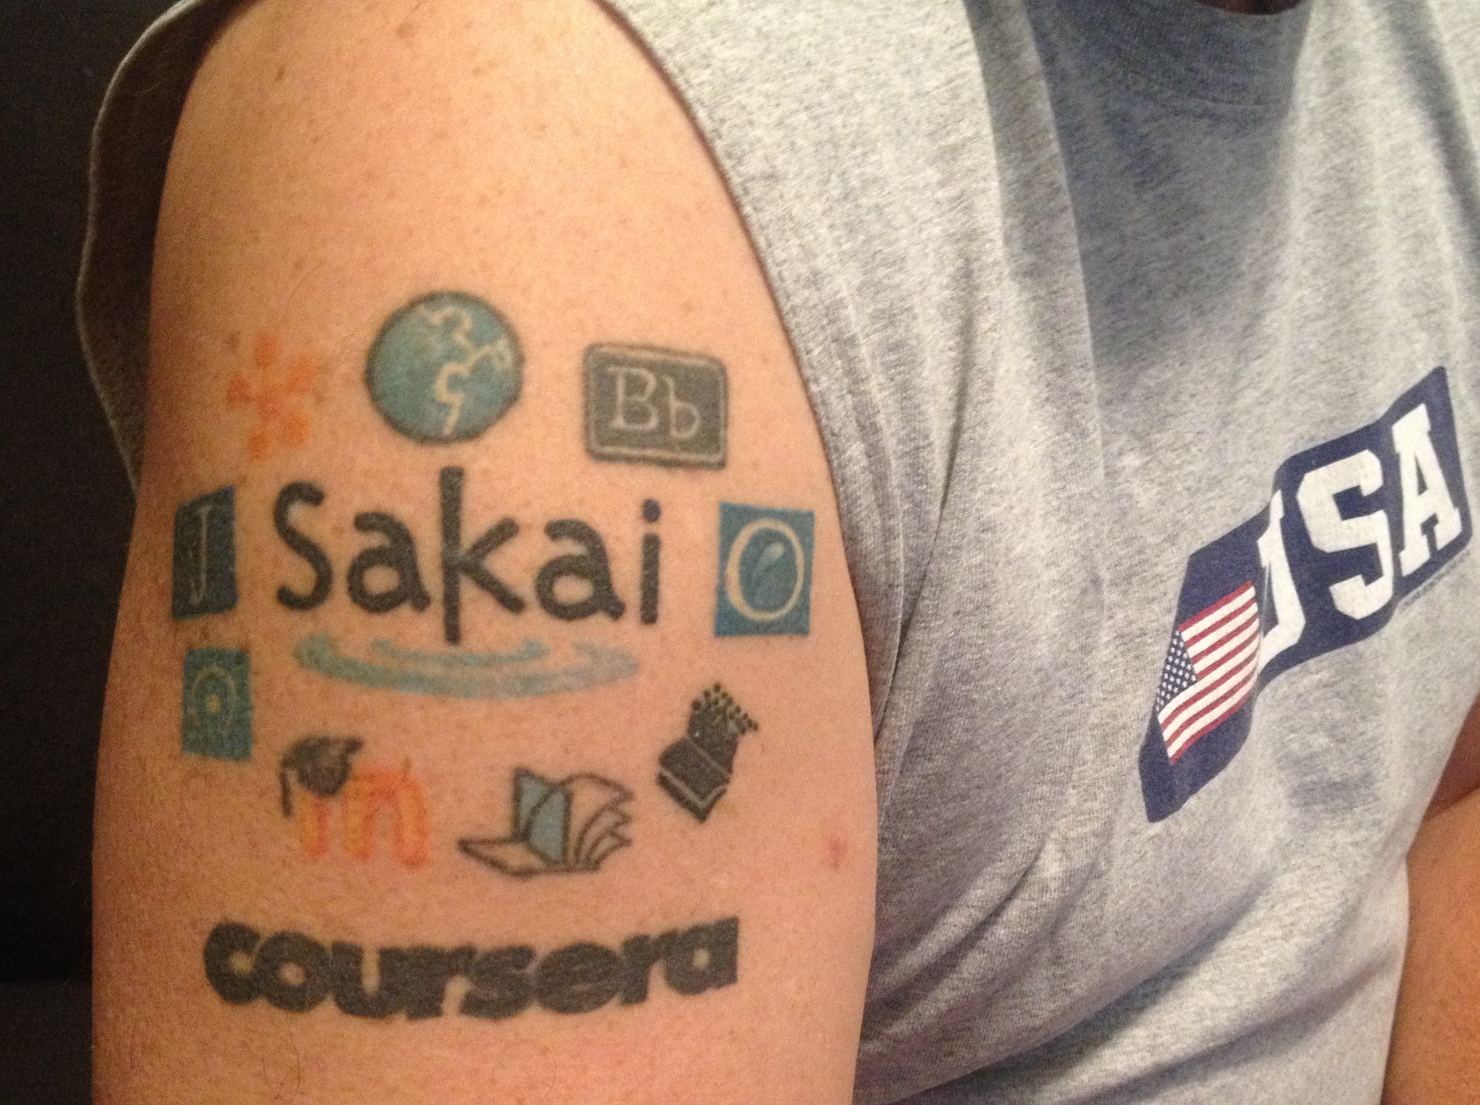
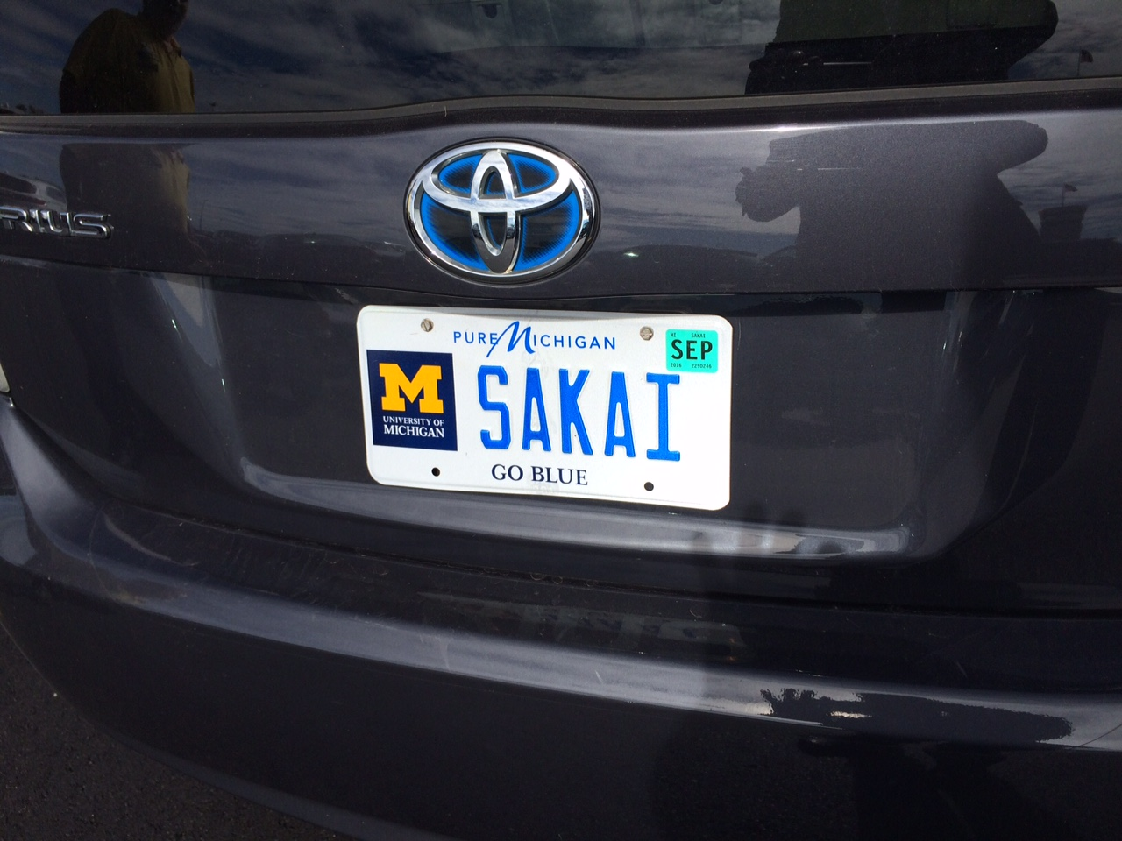
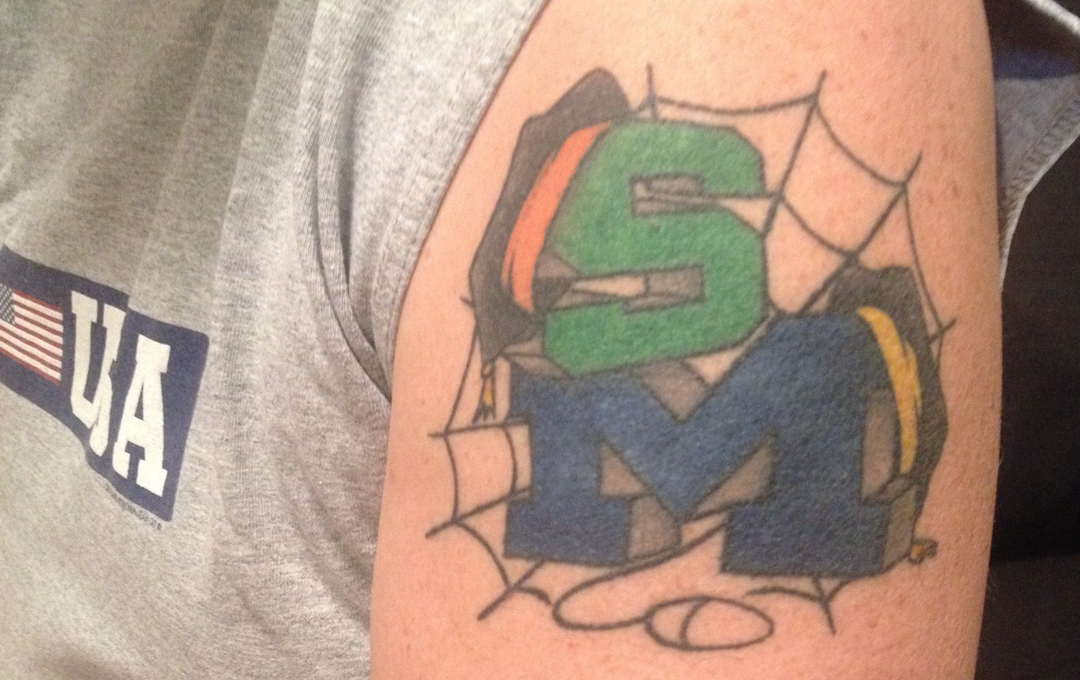
In building the next generation, open source will be first to market..

Slide 51
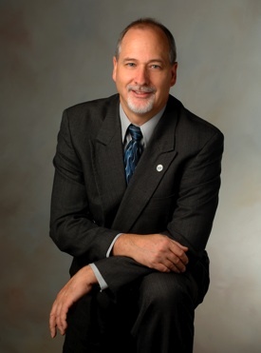
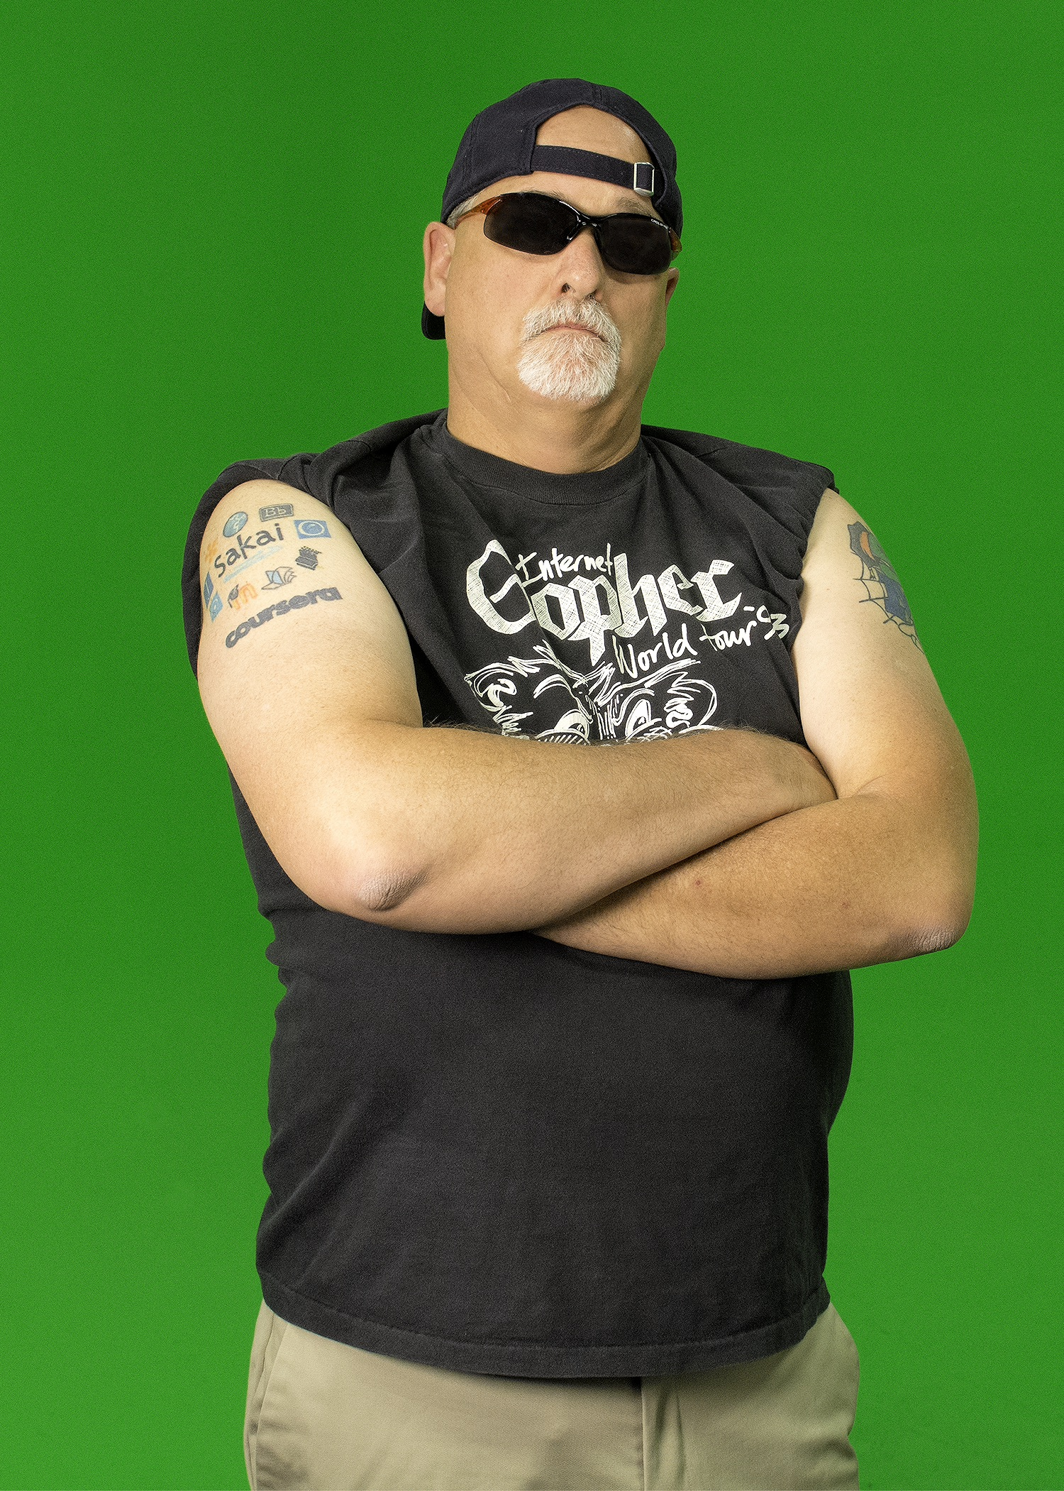
In building the NGDLE, open source will be first to market..

